Slide 1



Slide 2
Helping Students
to Realize Their Dreams
for the Last 14 Years

Slide 3
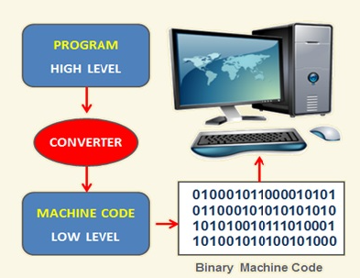

Fundamentals of Programming
Introduction to Computer Programs
It is a step by step process of designing and developing various sets of computer programs to accomplish a specific computing outcome.
Elements of Computer Programs
Programming Environment
Data Types
Variables
Keywords
Logical and Arithmetical Operators
If else conditions
Loops
Numbers, Characters and Arrays
Functions
Input and Output Operations
Notes:
Estimated time: 5 mins

Slide 4
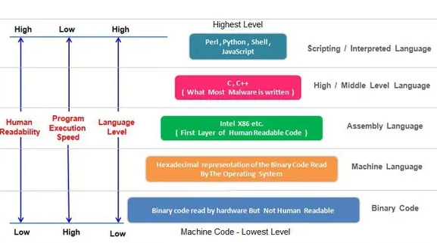
Fundamentals of Programming
Types of Programming Languages
Notes:
Estimated time: 5 mins

Slide 5
Fundamentals of Programming
Competitive Programming
Competitive programming is a mind sport usually held over the Internet or a local network, involving participants trying to program according to provided specifications.
One of the oldest contests known is ICPC which originated in the 1970s, and has grown to include 88 countries in its 2011 edition.
The aim of competitive programming is to write source code of computer programs which are able to solve given problems.
Typical such tasks belong to one of the following categories: combinatorics, number theory, graph theory, algorithmic game theory, computational geometry, string analysis and data structures
Competitive programming is typically the first or second round of hiring for SDE roles
Notes:
Estimated time: 10 mins

Slide 6

Getting Started with Java
Introduction to Java
Java is a programming language and a platform. It is a high level, secure, robust and an Object Oriented programming language
The syntax of Java is based on C
There are no pointers in Java and there is automatic garbage collection
The features of Java are as given in the diagram
Notes:
Estimated time: 15-20 mins

Slide 7
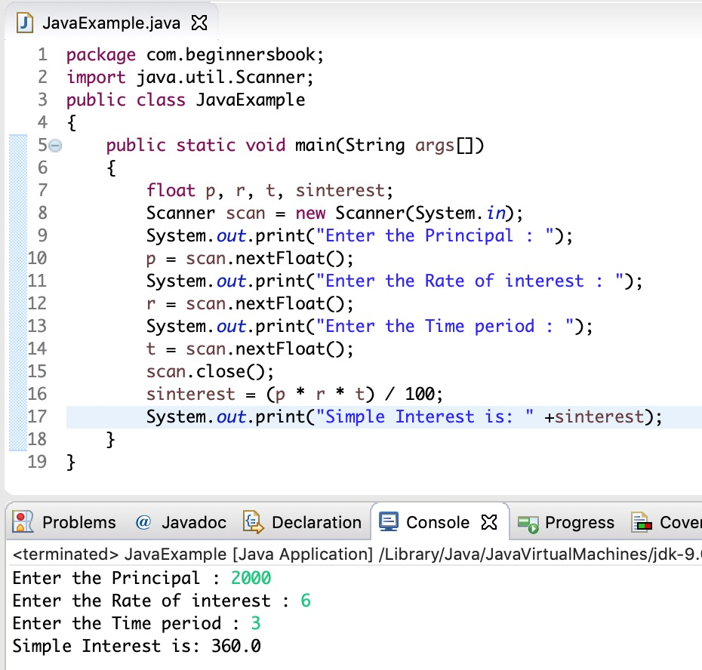
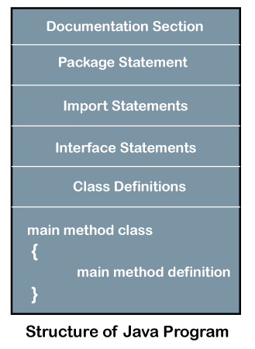
Getting Started with Java
Example and Structure
Notes:
Estimated time: 10 mins

Slide 8
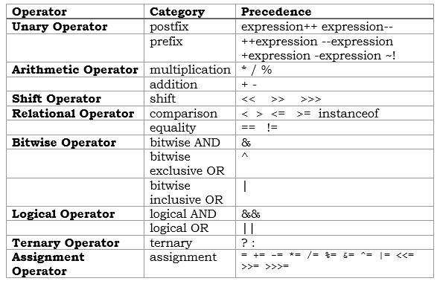
Getting Started with Java
Java in a nutshell
Data Types: boolean, int, float, char
I/O: System.out and Scanner
Operators: Unary, Arithmetic etc.
Decision Statements: If, else, if-else, switch
Looping: while, do-while, for, for-each etc
Notes:
Estimated time: 10 mins

Slide 9
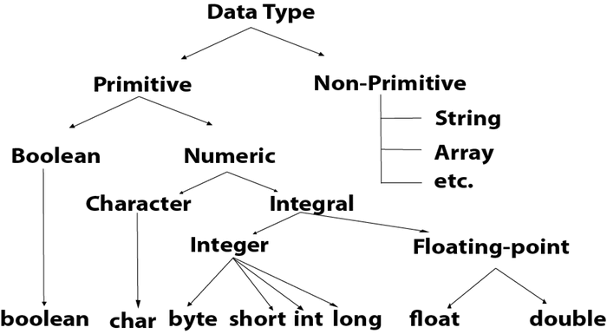
Java: Data Types
Data Types in Java
Notes:
Estimated time: 10 mins

Slide 10
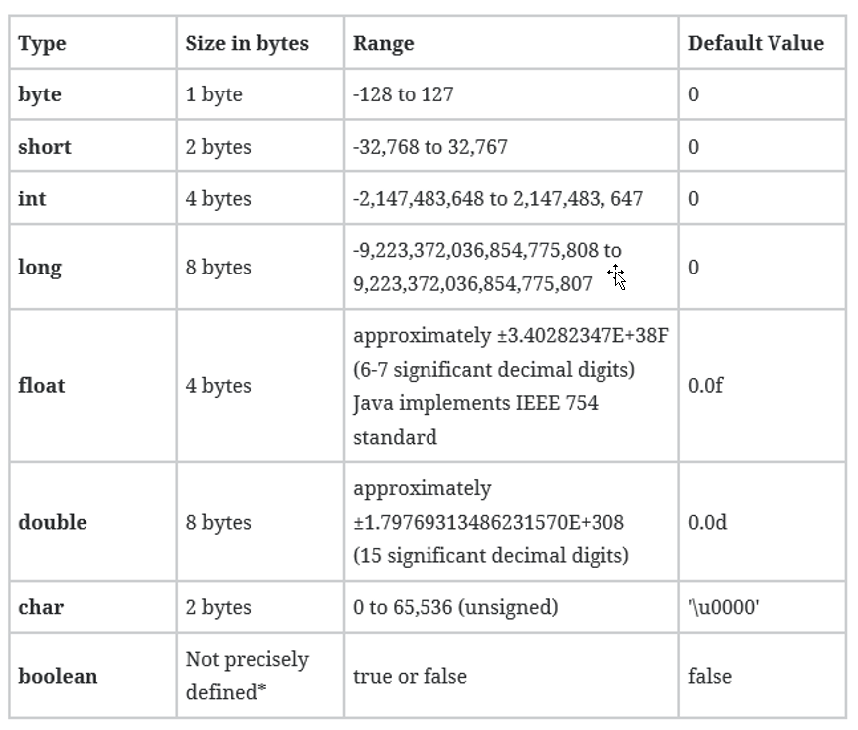
Java: Data Types
Primitive Data Types
boolean
byte
char
short
int
long
float
double
Notes:
Estimated time: 10 mins

Slide 11
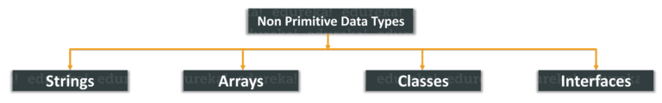
Java: Data Types
Non-Primitive Data Types
Strings: String is a sequence of characters. But in Java, a string is an object that represents a sequence of characters. The java.lang.String class is used to create a string object.
Arrays: Arrays in Java are homogeneous data structures implemented in Java as objects. Arrays store one or more values of a specific data type and provide indexed access to store the same. A specific element in an array is accessed by its index.
Classes: A class in Java is a blueprint which includes all your data. A class contains fields(variables) and methods to describe the behavior of an object.
Interface: Like a class, an interface can have methods and variables, but the methods declared in interface are by default abstract (only method signature, no body).
Notes:
Estimated time: 10 mins

Slide 12
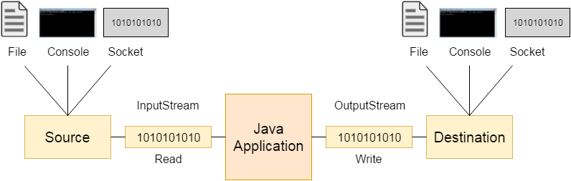
Input and Output
Java IO
A stream is a sequence of data. In Java, a stream is composed of bytes.
There are three default streams in Java:-
System.out: standard output stream. Eg: System.out.println("simple message");
System.in: standard input stream. int i=System.in.read();
System.err: standard error stream. Eg: System.err.println("error message");
Scanner is a class in java.util package used for obtaining the input of the primitive types like int, double, etc. and strings. It is popularly used for reading from the input stream
Notes:
Estimated time: 10 mins

Slide 13
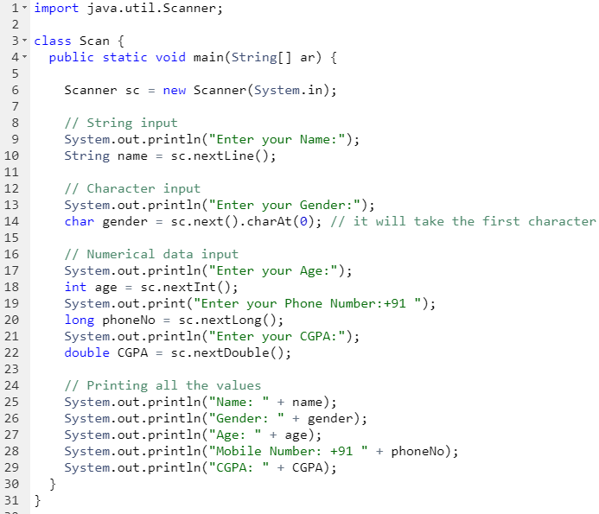
Input and Output
Java IO - Example
Notes:
Estimated time: 10 mins

Slide 14
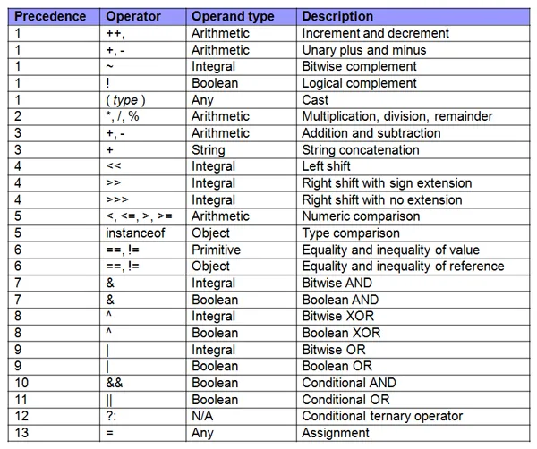
Operators
Operators in Java
Notes:
Estimated time: 10 mins

Slide 15
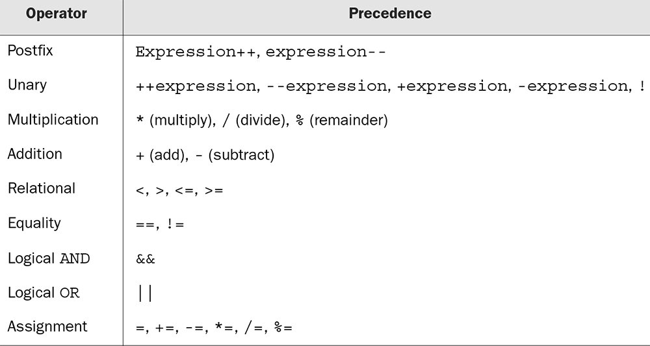
Operators
Associativity and Precedence of Operators
Notes:
Estimated time: 10 mins

Slide 16
Decision Making
Decision Making in Java
The decision making statements in Java include the following keywords:-
if Statement
if: An if statement consists of a boolean expression followed by one or more statements.
if-else: An if statement can be followed by an optional else statement, which executes when the boolean expression is false.
nested-if: You can use one if or else if statement inside another if or else if statement(s).
switch statement
ternary operator
Notes:
Estimated time: 10 mins

Slide 17
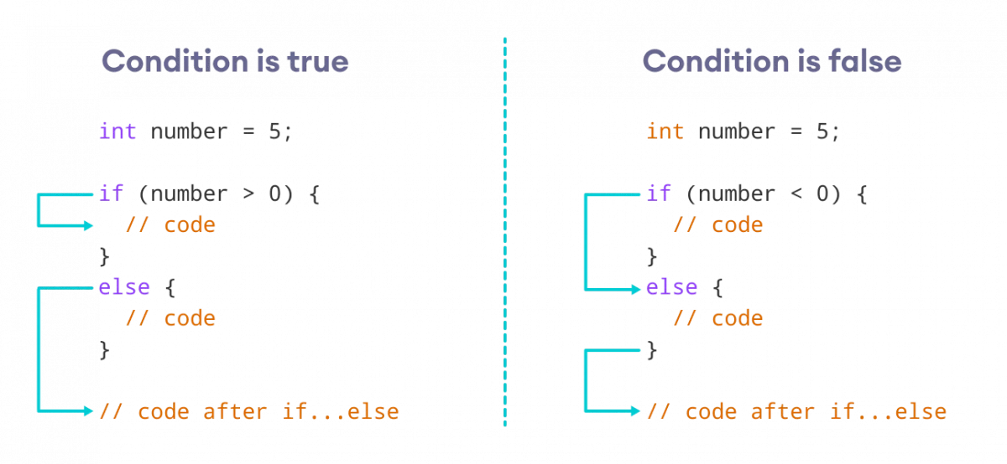
Decision Making
Decision Making in Java
Notes:
Estimated time: 10 mins

Slide 18
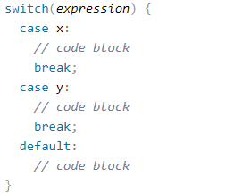
Decision Making
Ternary operator and Switch Statement
Ternary operator in Java will be in the form of condition?true-expression:false-expression
Switch statement is executes one statement from multiple conditions.
The switch statement works with byte, short, int, long, enum types, String and some wrapper
types like Byte, Short, Int, and Long.
Since Java 7, you can use strings in the switch statement.
Notes:
Estimated time: 10 mins

Slide 19
Introduction to Algorithms
Algorithms
An algorithm is a step-by-step method for solving some problem.
Definition: “In mathematics and computer science, an algorithm is a finite sequence of well-defined, computer-implementable instructions, typically to solve a class of specific problems or to perform a computation.”
We need algorithms because of the following reasons:
Scalability: It helps us to understand the scalability. When we have a big real-world problem, we need to scale it down into small-small steps to easily analyze the problem.
Performance: The real-world is not easily broken down into smaller steps. If the problem can be easily broken into smaller steps means that the problem is feasible.
Notes:
Estimated time: 10 mins

Slide 20
Introduction to Algorithms
Characteristics of Algorithm
Algorithms generally have the following characteristics:
Clear and Unambiguous: Algorithm should be clear and unambiguous. Each of its steps should be clear in all aspects and must lead to only one meaning.
Well-Defined Inputs: If an algorithm says to take inputs, it should be well-defined inputs.
Well-Defined Outputs: The algorithm must clearly define what output will be yielded and it should be well-defined as well.
Finiteness: The algorithm must be finite, i.e. it should not end up in an infinite loops or similar.
Feasible: The algorithm must be simple, generic and practical, such that it can be executed upon will the available resources.
Language Independent: The Algorithm designed must be language-independent, i.e. it must be just plain instructions that can be implemented in any language, and yet the output will be same, as expected.
Notes:
Estimated time: 10 mins

Slide 21
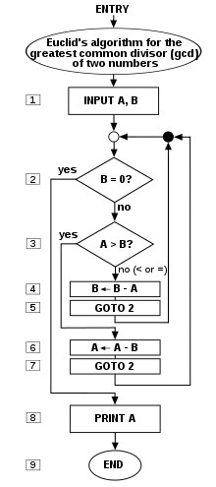
Introduction to Algorithms
Dataflow of an Algorithm
Problem: A problem can be a real-world problem or any instance from the real-world problem for which we need to create a program or the set of instructions. The set of instructions is known as an algorithm.
Algorithm: An algorithm will be designed for a problem which is a step by step procedure.
Input: After designing an algorithm, the required and the desired inputs are provided to the algorithm.
Processing unit: The input will be given to the processing unit, and the processing unit will produce the desired output.
Output: The output is the outcome or the result of the program.
On the right side, the flow of Euclid’s algorithm to calculate GCD of two numbers are given.
Notes:
Estimated time: 10 mins

Slide 22
Introduction to Algorithms
Issues while designing Algorithms
How to design algorithms:
As we know that an algorithm is a step-by-step procedure so we must follow some steps to design an algorithm.
Designing algorithm is not a one step process, we need different approaches for different algorithms
How to analyse algorithm efficiency
We cannot determine efficiency of an algorithm by benchmarking its speed. We need a sophisticated method to analyse an efficiency of an algorithm.
Notes:
Estimated time: 10 mins

Slide 23
Introduction to Algorithms
Issues while designing Algorithms
How to design algorithms:
As we know that an algorithm is a step-by-step procedure so we must follow some steps to design an algorithm.
Designing algorithm is not a one step process, we need different approaches for different algorithms
How to analyse algorithm efficiency
We cannot determine efficiency of an algorithm by benchmarking its speed. We need a sophisticated method to analyse an efficiency of an algorithm.
Notes:
Estimated time: 10 mins

Slide 24
Introduction to Algorithms
Types of approaches to solve while designing an algorithm:-
1. Brute force approach
2. Divide and Conquer
3. Greedy approach
4. Dynamic programming
5. Branch and Bound
6. Randomized Algorithm
7. Backtracking
Notes:
Estimated time: 10 mins

Slide 25
Time and Space Complexity
Algorithm Complexity
We need to learn how to compare the performance different algorithms and choose the best one to solve a particular problem.
While analyzing an algorithm, we mostly consider time complexity and space complexity.
Time complexity of an algorithm quantifies the amount of time taken by an algorithm to run as a function of the length of the input.
Space complexity of an algorithm quantifies the amount of space or memory taken by an algorithm to run as a function of the length of the input.
Notes:
Estimated time: 10 mins

Slide 26
Time and Space Complexity
Time and space complexity depends on lots of things like hardware, operating system, processors, etc.
However, we don't consider any of these factors while analyzing the algorithm. We will only consider the execution time of an algorithm.
Lets start with a simple example. Suppose you are given an array and an integer and you have to find if exists in array .
Simple solution to this problem is traverse the whole array and check if the any element is equal to x
for i : 1 to length of A
if A[i] is equal to x
return TRUE
return FALSE
Notes:
Estimated time: 10 mins

Slide 27
Time and Space Complexity
for i : 1 to length of A
if A[i] is equal to x
return TRUE
return FALSE
Consider the above problem.
Each of the operation in computer take approximately constant time.
Let each operation takes ‘c’ time. The number of lines of code executed is actually depends on the value of ‘x’.
The worst case scenario: The if condition will run ‘x’ if the array isn’t found
Best Case scenario: The if case will be run only once (element will be found in the first pass
The space requirement is constant. It is so because we store only an array and no additional space is required
Notes:
Estimated time: 10 mins

Slide 28
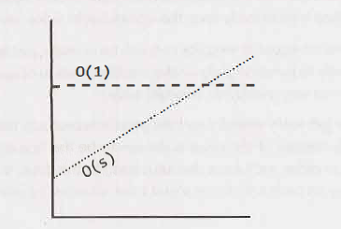
Big O
No matter how big the constant is and how slow the linear increase is, linear will at some point surpass constant.
There are many more runtimes than this. Some of the
most common ones are O(log N), O(N log N), O(N),
O(N2) and 0( 2N).
There's no fixed list of possible runtimes, though.
You can also have multiple variables in your runtime.
For example, the time to paint a fence that's w meters
wide and h meters high could be described as O ( wh).
If you needed p layers of paint, then you could say that the time is O ( whp).
Notes:
Estimated time: 10 mins

Slide 29
Big 0, Big Theta, and Big Omega
big 0, big theta, and big omega are used to describe runtimes.
O (big Oh): Big O describes an upper bound on the time. An algorithm that prints all the values in an array could be described as O(N), but it could also be described as O(N2), O(N3), or 0( 2N) (or many other big O times).
The algorithm is at least as fast as each of these; therefore they are upper bounds on the runtime. This is similar to a less-than-or-equal-to relationship.
A simple algorithm to print the values in an array is O(N)
big omega: Omega is the equivalent concept but for lower bound. Printing the values in
an array is O(N) as well as O(log N) and 0(1). After all, you know that it won't be faster than those runtimes.
big theta: Theta means both O and Omega. That is, an algorithm is Theta(N) if it is both O(N) and Omega( N)
Notes:
Estimated time: 10 mins

Slide 30
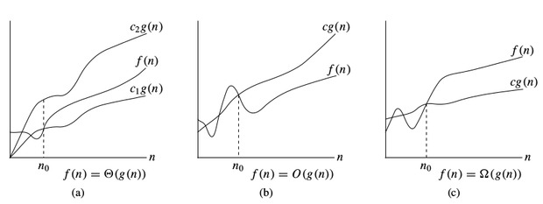
Big 0, Big Theta, and Big Omega
Notes:
Estimated time: 10 mins

Slide 31
Time Complexity
The time complexity of an algorithm quantifies the amount of time taken by an algorithm to run as a function of the length of the input.
Note that the time to run is a function of the length of the input and not the actual execution time of the machine on which the algorithm is running on.
This is what the concept of asymptotic runtime, or big O time, means. We could describe the data transfer "algorithm" runtime as:
Electronic Transfer: O(s), where s is the size of the file. This means that the time to transfer the file increases linearly with the size of the file. (Yes, this is a bit of a simplification, but that's okay for these purposes.)
Airplane Transfer: 0(1) with respect to the size of the file. As the size of the file increases, it won't take any longer to get the file to your friend. The time is constan
Notes:
Estimated time: 10 mins

Slide 32
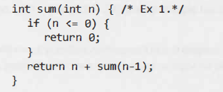
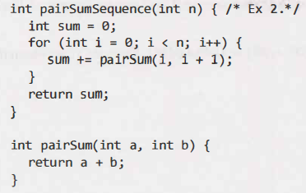
Space Complexity
Time is not the only thing that matters in an algorithm. We might also care about the amount of memory or space-required by an algorithm.
Space complexity is a parallel concept to time complexity. If we need to create an array of size n, this will require 0(n) space.
If we need a two-dimensional array of size nxn, this will require O(n2) space.
\
Ex.1: Each call adds to the call stack ‘n’ times. Hence space complexity is O(n). However, just because you have n calls total doesn't mean it takes O(n) space. Consider Ex 2. There will be roughly O(n) calls to pairSum. However, those calls do not exist simultaneously on the call
stack, so you only need O(1) space.
Notes:
Estimated time: 10 mins

Slide 33
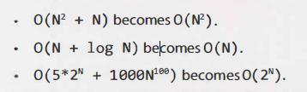
Conditions
It is very possible for O(N) code to run faster than 0( 1) code for specific inputs. Big O just describes the rate of increase.
For this reason, we drop the constants in runtime. An algorithm that one might have described as 0(2N) is actually O(N).
For Eg:
for(i=0;i<N;i++){
print(x[1])
print(y[1])
}
Both can be considered the same. The frist is O(n) and second is O(2n) which can be represented as O(n)
The second rule is that you can drop the termis which aren’t significant. In this case:-
for(i=0;i<N;i++){
print(x[1])
}
for(i=0;i<N;i++){
print(y[1])
}
Notes:
Estimated time: 10 mins

Slide 34
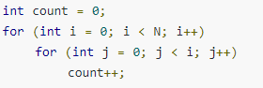
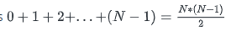
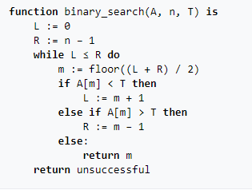
Examples
The Time complexity of this code will be O(N^2) as for i=0, it will
run 0 times, i=2 it woll run 2 times and hence O(N^2)
An algorithm like binary search takes O(logN) as the time complexity as n every iteration array N is divided into N/2 times.
When i=N, it will do N/2 comparisons in the worst case.
When i=N/2, it will do N/4 comparisons in the worst case
Hence the time complexity of binary search is O(logN).
Notes:
Estimated time: 10 mins

Slide 35
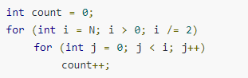
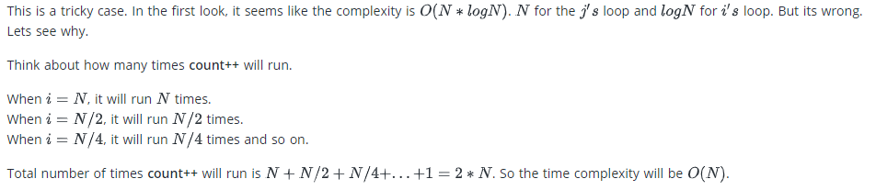
Examples
Notes:
Estimated time: 10 mins

Slide 36
Sieve of Eratosthenes
Introduction
The sieve of Eratosthenes is an ancient algorithm for finding all prime numbers up to any given limit.
It does so by iteratively marking as composite (i.e., not prime) the multiples of each prime, starting with the first prime number, 2.
The multiples of a given prime are generated as a sequence of numbers starting from that prime, with constant difference between them that is equal to that prime
This is the sieve's key distinction from using trial division to sequentially test each candidate number for divisibility by each prime.
Once all the multiples of each discovered prime have been marked as composites, the remaining unmarked numbers are primes.
Notes:
Estimated time: 10 mins

Slide 37
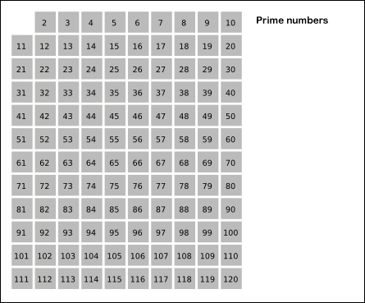
Sieve of Eratosthenes
The Sieve in Action
The steps of the algorithm to find all primes below 121
Notes:
This is a gif file. It will be animated in presentation mode

Slide 38
Sieve of Eratosthenes
Algorithm
To find all the prime numbers less than or equal to 30, proceed as follows.
First, generate a list of integers from 2 to 30
The first number in the list is 2; cross out every 2nd number in the list after 2 by counting up from 2 in increments of 2 (these will be all the multiples of 2 in the list):
The next number in the list after 2 is 3; cross out every 3rd number in the list after 3 by counting up from 3 in increments of 3 (these will be all the multiples of 3 in the list)
The next number not yet crossed out in the list after 3 is 5; cross out every 5th number in the list after 5 by counting up from 5 in increments of 5 (i.e. all the multiples of 5):
The next number not yet crossed out in the list after 5 is 7; the next step would be to cross out every 7th number in the list after 7, but they are all already crossed out at this point, as these numbers (14, 21, 28) are also multiples of smaller primes because 7 × 7 is greater than 30. The numbers not crossed out at this point in the list are all the prime numbers below 30:
Notes:
This is a gif file. It will be animated in presentation mode

Slide 39
Sieve of Eratosthenes
Algorithm
algorithm Sieve of Eratosthenes is
input: an integer n > 1.
output: all prime numbers from 2 through n.
let A be an array of Boolean values, indexed by integers 2 to n,
initially all set to true.
for i = 2, 3, 4, ..., not exceeding √n do
if A[i] is true
for j = i2, i2+i, i2+2i, i2+3i, ..., not exceeding n do
A[j] := false
return all i such that A[i] is true.
Time Complexity: O(nlog(logn))
Notes:
Teach the Program for the students

Slide 40
Sieve of Eratosthenes
Program: Sieve of Eratosthanes in Java
Sample Input/Output
Input : n =10
Output : 2 3 5 7
Input : n = 20
Output: 2 3 5 7 11 13 17 19
Notes:
Teach the Program for the students

Slide 41
Sieve of Eratosthenes
Other types of Sieves
The simple sieve algorithm produces all primes not greater than n.
It includes a common optimization, which is to start enumerating the multiples of each prime i from i2.
The time complexity of this algorithm is O(n log log n), provided the array update is an O(1) operation, as is usually the case.
The problem with the sieve of Eratosthenes is not the number of operations it performs but rather its memory requirements.
For large n, the range of primes may not fit in memory; worse, even for moderate n, its cache use is highly suboptimal.
The simple sieve algorithm walks through the entire array A, exhibiting almost no locality of reference
Locality of Reference: In computer science, locality of reference, also known as the principle of locality, is the tendency of a processor to access the same set of memory locations repetitively over a short period of time
Notes:
Teach the Program for the students

Slide 42
Segmented Sieves
Introduction
A solution to these problems is offered by segmented sieves, where only portions of the range are sieved at a time.
The idea of a segmented sieve is to divide the range [0..n-1] in different segments and compute primes in all segments one by one.
This algorithm first uses Simple Sieve to find primes smaller than or equal to √(n).
In Simple Sieve, we needed O(n) space which may not be feasible for large n.
Here we need O(√n) space and we process smaller ranges at a time (locality of reference)

Slide 43
Segmented Sieves
Algorithm: Segmented Sieves
Use Simple Sieve to find all primes up to the square root of ‘n’ and store these primes in an array “prime[]”. Store the found primes in an array ‘prime[]’.
We need all primes in the range [0..n-1]. We divide this range into different segments such that the size of every segment is at-most √n
Do following for every segment [low..high]
Create an array mark[high-low+1]. Here we need only O(x) space where x is a number of elements in a given range.
Iterate through all primes found in step 1. For every prime, mark its multiples in the given range [low..high].

Slide 44
Segmented Sieves
Program: Segmented Sieves
Sample I/O
Input
n=100
Output
2 3 5 7 11 13 17 19 23 29 31 37 41
43 47 53 59 61 67 71 73 79 83 89 97
Note
The time complexity (or a number of operations) by Segmented Sieve is the same as Simple Sieve.
It has advantages for large ‘n’ as it has better locality of reference thus allowing better caching by the CPU and also requires less memory space.

Slide 45
Incremental Sieve
Introduction
The standard Sieve of Eratosthenes requires that you specify an upper bound before you start
But often, programs that use prime numbers don’t know the upper bound in advance, or don’t want to pre-compute and store all of the primes up to their bound.
In such cases, Incremental Sieve algorithm can be used
An incremental formulation of the sieve generates primes indefinitely (i.e. without an upper bound) by interleaving the generation of primes with the generation of their multiples (so that primes can be found in gaps between the multiples), where the multiples of each prime p are generated directly, by counting up from the square of the prime in increments of p (or 2p for odd primes)
The generation must be initiated only when the prime's square is reached, to avoid adverse effects on efficiency. It can be expressed symbolically under the dataflow paradigm as
primes = [2, 3, ...] \ [[p², p²+p, ...] for p in primes]
Where \ denotes the set subtraction of arithmetic progressions of numbers.

Slide 46
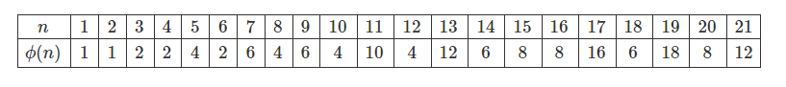
Euler’s Phi Algorithm
Introduction
Euler's totient function, also known as phi-function ϕ(n), counts the number of integers between 1 and n inclusive, which are coprime to n
Two numbers are coprime if their greatest common divisor equals 1 (1 is considered to be coprime to any number).
Here are values of ϕ(n) for the first few positive integers:
Examples:
Φ(4) = 2
gcd(1, 4) is 1 and gcd(3, 4) is 1
Φ(5) = 4
gcd(1, 5) is 1, gcd(2, 5) is 1,
gcd(3, 5) is 1 and gcd(4, 5) is 1
Φ(6) = 2
gcd(1, 6) is 1 and gcd(5, 6) is 1,

Slide 47
Euler’s Phi Algorithm
Basic Algorithm
A simple solution is to iterate through all numbers from 1 to n-1 and count numbers with gcd with n
EulerPhi1.java
Time Complexity: O(N log N)

Slide 48
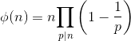
Euler’s Phi Algorithm
Better Solution
The idea is based on Euler’s product formula which states that the value of totient functions is below the product overall prime factors p of n.
The formula basically says that the value of Φ(n) is equal to n multiplied by-product of (1 – 1/p) for all prime factors p of n. For example value of Φ(6) = 6 * (1-1/2) * (1 – 1/3) = 2.

Slide 49
Euler’s Phi Algorithm
Better Solution - 1
Program: EulerPhi2.java
Algorithm
1) Initialize : result = n
2) Run a loop from 'p' = 2 to sqrt(n), do following for every 'p'.
a) If p divides n, then
Set: result = result * (1.0 - (1.0 / (float) p));
Divide all occurrences of p in n.
3) Return result

Slide 50
Euler’s Phi Algorithm
Better Solution - 2
Program: EulerPhi3.java
We can avoid floating-point calculations in the above method. The idea is to count all prime factors and their multiples and subtract this count from n to get the totient function value (Prime factors and multiples of prime factors won’t have GCD as 1)
Algorithm
1) Initialize result as n
2) Consider every number 'p' (where 'p' varies from 2 to Φn).
If p divides n, then do following
a) Subtract all multiples of p from 1 to n [all multiples of p will have gcd more than 1 (at least p) with n]
b) Update n by repeatedly dividing it by p.
3) If the reduced n is more than 1, then remove all multiples of n from result.

Slide 51
Strobogrammatic Number
Introduction
Strobogrammatic Number is a number whose numeral is rotationally symmetric so that it appears the same when rotated 180 degrees.
In other words, Strobogrammatic Number appears the same right-side up and upside down.
When written using standard characters (ASCII), the numbers, 0, 1, 8 are symmetrical around the horizontal axis, and 6 and 9 are the same as each other when rotated 180 degrees.
In such a system, the first few strobogrammatic numbers are:
0, 1, 8, 11, 69, 88, 96, 101, 111, 181, 609, 619, 689, 808, 818, 888......
The years 1881 and 1961 were the most recent strobogrammatic years; the next strobogrammatic year will be 6009.

Slide 52
Strobogrammatic Number
Examples
0 after 180° rotation : (0 → 0)
1 after 180° rotation : (1 → 1)
8 after 180° rotation : (8 → 8)
6 after 180° rotation : (6 → 9)
9 after 180° rotation : (9 → 6)

Slide 53
Strobogrammatic Number
Program
StrobogrammaticNumber.java
For the given length n, find all n-length Strobogrammatic numbers.

Slide 54
Strobogrammatic Number
Program
StrobogrammaticNumber2.java
Given number n, check if it is a Strobogrammatic Number.
Sample IO
Input: "69"
Output: true
Input: "88"
Output: true
Input: "962"
Output: false

Slide 55
Remainder Theorem
Introduction
Also known as the Chinese Remainder Theorem
The Chinese remainder theorem states that if one knows the remainders of the Euclidean division of an integer x by several integers, then one can determine uniquely the remainder of the division of x by the product of these integers, under the condition that the divisors are pairwise coprime.
We are given two arrays num[0..k-1] and rem[0..k-1].
In num[0..k-1], every pair is coprime (gcd for every pair is 1). We need to find minimum positive number x such that:
x % num[0] = rem[0],
x % num[1] = rem[1],
.......................
.......................
.......................
x % num[k-1] = rem[k-1]
Note that the integers in the num array would be pairwise coprime.

Slide 56
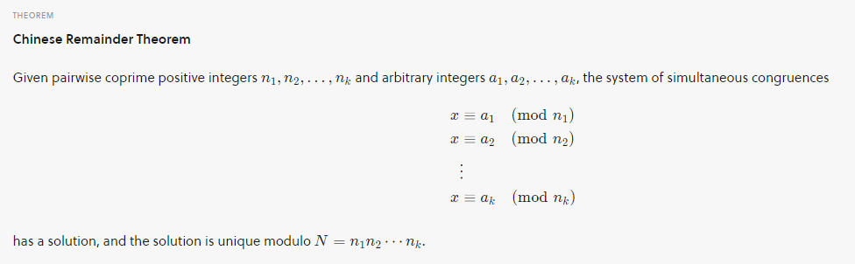
Remainder Theorem
Explanation
Basically, we are given k numbers which are pairwise coprime, and given remainders of these numbers when an unknown number x is divided by them.
We need to find the minimum possible value of x that produces given remainders.
Chinese Remainder Theorem states that there always exists an x that satisfies given congruences
Let nums = [n1, n2, n3... nk] and rems= [a1, a2, a3...ak]. Then, for any given sequence of integers rem[0], rem[1], … rem[k-1], there exists an integer x solving the following system of simultaneous congruences.

Slide 57
Remainder Theorem
Program
ChineseRemainderThm.java
Sample IO
Input
num= [5, 7]
rem = [1, 3]
Output
31
Input
num= [3, 4, 5]
rem = [2, 3, 1]
Output
11
Explanation
31 is the smallest number such that:
(1) When we divide it by 5, we get remainder 1.
(2) When we divide it by 7, we get remainder 3.
Explanation
11 is the smallest number such that:
(1) When we divide it by 3, we get remainder 2.
(2) When we divide it by 4, we get remainder 3.
(3) When we divide it by 5, we get remainder 1.

Slide 58
Binary Palindrome
Introduction
You are given an integer ‘X’, you need to convert the integer to binary format and check if the binary format is palindrome or not
For Example, 5 i.e. 101, 27 i.e. 11011 are numbers whose binary representations are palindromes. Wheras 10 i.e. 1011 and 20 i.e. 10100 are not palindromes
The problem is very similar to checking whether a string is palindrome or not. Hence the binary representation must be strings.
We start from leftmost and rightmost bits and compare bits one by one. If we find a mismatch, then return false.
We can use the regular palindrome program. Converting integer ‘val’ to binary is as easy as Integer.toBinaryString(val)

Slide 59
Binary Palindrome
Program
Check whether a string is palindrome or not
palindrome1.java
Sample IO
Input: madam
Output: The string is palindrome
Input: deed
Output: The string is palindrome
Input: algorithm
Output: The string is not palindrome

Slide 60
Binary Palindrome
Find the nth number whose binary representation is a palindrome
Find the nth number whose binary representation is a palindrome.
A special caution that you should not consider the leading zeros, while considering the binary representation.
Approach: Traverse through all the integers from 1 to 2^31 – 1 and increment palindrome count, if the number is a palindrome. When the palindrome count reaches the required n, break the loop and return the current integer.

Slide 61
Binary Palindrome
Programs
palindrome2.java
Sample IO
Input : 1
Output : 1
1st Number whose binary representation
is palindrome is 1 (1)
Input : 9
Output : 27
9th Number whose binary representation
is palindrome is 27 (11011)

Slide 62
Booth's Algorithm
Introduction
The booth algorithm is a multiplication algorithm that allows us to multiply the two signed binary integers in 2's complement, respectively.
It is also used to speed up the performance of the multiplication process. It is very efficient too.
It works on the string bits 0's in the multiplier that requires no additional bit only shift the right-most string bits and a string of 1's in a multiplier bit weight 2k to weight 2m that can be considered as 2k+ 1 - 2m.

Slide 63
Booth's Algorithm
Flowchart
As in all multiplication schemes, booth algorithm requires examination of the multiplier bits and shifting of the partial product.
Prior to the shifting, the multiplicand may be added to the partial product, subtracted from the partial product, or left unchanged according to following rules:
The multiplicand is subtracted from the partial product upon encountering the first least significant 1 in a string of 1’s in the multiplier
The multiplicand is added to the partial product upon encountering the first 0 (provided that there was a previous ‘1’) in a string of 0’s in the multiplier.
The partial product does not change when the multiplier bit is identical to the previous multiplier bit.

Slide 64
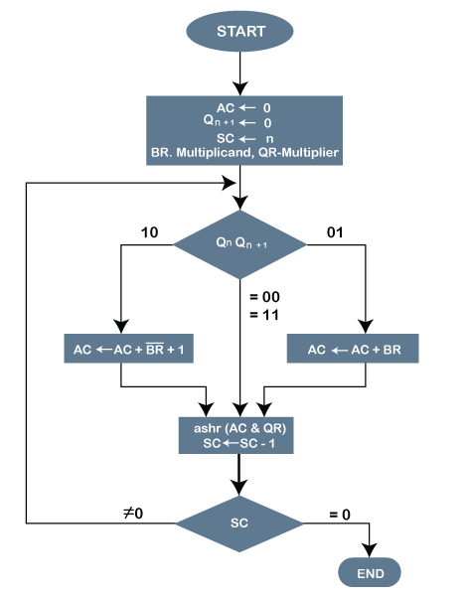
Booth's Algorithm
Flowchart
Initially, AC and Qn + 1 bits are set to 0
The SC is a sequence counter that represents the total bits set n, which is equal to the number of bits in the multiplier.
There are BR that represent the multiplicand bits, and QR represents the multiplier bits.
After that, we encountered two bits of the multiplier as Qn and Qn + 1, where Qn represents the last bit of QR, and Qn + 1 represents the incremented bit of Qn by 1.
Suppose two bits of the multiplier is equal to 10; it means that we have to subtract the multiplier from the partial product in the accumulator AC and then perform the arithmetic shift operation (ashr).
If the two of the multipliers equal to 01, it means we need to perform the addition of the multiplicand to the partial product in accumulator AC and then perform the arithmetic shift operation (ashr), including Qn + 1.
The arithmetic shift operation is used in Booth's algorithm to shift AC and QR bits to the right by one and remains the sign bit in AC unchanged.
And the sequence counter is continuously decremented till the computational loop is repeated, equal to the number of bits (n).

Slide 65
Booth's Algorithm
Algorithm
Set the Multiplicand and Multiplier binary bits as M and Q, respectively.
Initially, we set the AC and Qn + 1 registers value to 0.
SC represents the number of Multiplier bits (Q), and it is a sequence counter that is continuously decremented till equal to the number of bits (n) or reached to 0.
A Qn represents the last bit of the Q, and the Qn+1 shows the incremented bit of Qn by 1.
On each cycle of the booth algorithm, Qn and Qn + 1 bits will be checked on the following parameters as follows:
When two bits Qn and Qn + 1 are 00 or 11, we simply perform the arithmetic shift right operation (ashr) to the partial product AC. And the bits of Qn and Qn + 1 is incremented by 1 bit.
If the bits of Qn and Qn + 1 is shows to 01, the multiplicand bits (M) will be added to the AC (Accumulator register). After that, we perform the right shift operation to the AC and QR bits by 1.
If the bits of Qn and Qn + 1 is shows to 10, the multiplicand bits (M) will be subtracted from the AC (Accumulator register). After that, we perform the right shift operation to the AC and QR bits by 1.
The operation continuously works till we reached n - 1 bit in the booth algorithm.
Results of the Multiplication binary bits will be stored in the AC and QR registers.

Slide 66
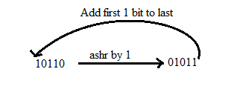
Booth's Algorithm
Methods used in Booth’s algorithm
RSC (Right Shift Circular)
It shifts the right-most bit of the binary number, and then it is added to the beginning of the binary bits.
RSA (Right Shift Arithmetic)
It adds the two binary bits and then shift the result to the right by 1-bit position.
Example: 0100 + 0110 => 1010, after adding the binary number shift each bit by 1 to the right and put the first bit of resultant to the beginning of the new bit.

Slide 67
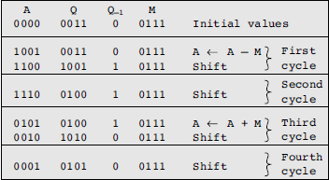
Booth's Algorithm
Example

Slide 68
Booth's Algorithm
Program
Booth1.java
Sample IO
Input
Enter two integer numbers
7 -7
Output
A : 0111 0000 0
S : 1001 0000 0
P : 0000 1001 0
P : 1100 1100 1
P : 0001 1110 0
P : 0000 1111 0
P : 1100 1111 1
Result : 7 * -7 = -49

Slide 69
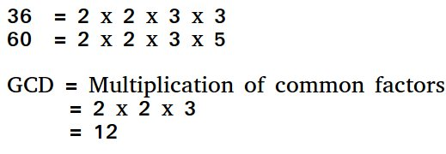
Euclid’s Algorithm
Introduction
Euclidean algorithm or Euclid's algorithm, is an efficient method for computing the greatest common divisor (GCD) of two integers (numbers), the largest number that divides them both without a remainder.
First the two numbers are subjected to prime factorizations, and the common factors of the two prime factorizations are multiplied to get the GCD

Slide 70
Euclid’s Algorithm
Idea
The algorithm is based on the below facts.
If we subtract a smaller number from a larger (we reduce a larger number), GCD doesn’t change. So if we keep subtracting repeatedly the larger of two, we end up with GCD.
Now instead of subtraction, if we divide the smaller number, the algorithm stops when we find remainder 0.

Slide 71
Binary Palindrome
Program
euclid1.java
Sample IO
Input : 10 15
Output : 5
Input : 35 10
Output : 5
Input : 31 2
Output : 1

Slide 72
Euclid’s Algorithm
Idea
Extended Euclidean algorithm also finds integer coefficients x and y such that:
ax + by = gcd(a, b)
The extended Euclidean algorithm updates results of gcd(a, b) using the results calculated by recursive call gcd(b%a, a).
Let values of x and y calculated by the recursive call be x1 and y1.
x and y are updated using the below expressions.
x = y1 - ⌊b/a⌋ * x1
y = x1

Slide 73
Binary Palindrome
Program
euclid2.java
Sample IO
Same as above, but you can also print the integer coefficients
The extended Euclidean algorithm is particularly useful when a and b are coprime.
With that provision, x is the modular multiplicative inverse of a modulo b, and y is the modular multiplicative inverse of b modulo a.
Similarly, the polynomial extended Euclidean algorithm allows one to compute the multiplicative inverse in algebraic field extensions and, in particular in finite fields of non prime order.
It follows that both extended Euclidean algorithms are widely used in cryptography.
In particular, the computation of the modular multiplicative inverse is an essential step in the derivation of key-pairs in the RSA public-key encryption method.

Slide 74
Karatsuba Algorithm
Introduction
The Karatsuba algorithm is a fast multiplication algorithm. It was discovered by Anatoly Karatsuba in 1960 and published in 1962.
It is a fast multiplication algorithm that uses a divide and conquer approach to multiply two numbers.
The naive algorithm for multiplying 2 numbers has a running time of O(n^2), wheras tkaratsuba algorithm has a runtime of
Being able to multiply numbers quickly is very important. Computer scientists often consider multiplication to be a constant time ~ O(1) operation which is reasonable for small numbers.
Wheras for larger numbers, the actual running times need to be factored in, which is O(n^2)

Slide 75
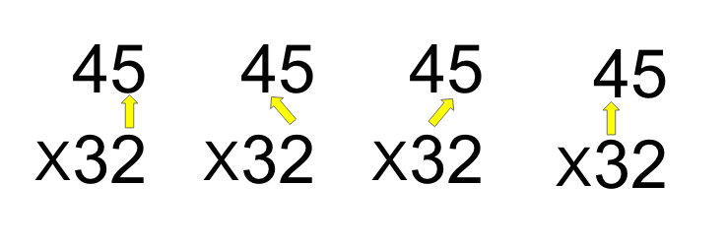
Karatsuba Algorithm
Naive Algorithm
The key idea is to reduce the four sub-problems in multiplication to three unique problems.
Thus, on calculating the three unique sub-problems, the original four sub-problems are solved using addition or subtraction operation.

Slide 76
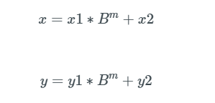
Karatsuba Algorithm
Explanation
Karatsuba stated that if we have to multiply two n-digit numbers x and y
The two numbers x and y has to be decomposed into 4 numbers x1, x2 and y1,y2
Eg: 45 * 32
45 can be represented as 4*10 + 5
Where x1 = 4, x2=5 with m=1
Note: B is the base (base-10 in this case)

Slide 77
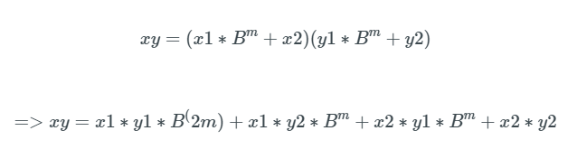
Karatsuba Algorithm
Explanation
The product of x and y after the decomposition can be represented by:-
Observe that there are 4 sub-problems:
X1 * Y1
X1 * Y2
X2 * Y1
X2 * Y2
We are going to reduce the 4 sub-problems to 3 sub-problems

Slide 78
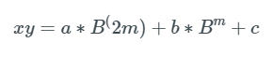
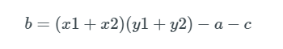
Karatsuba Algorithm
Procedure
Consider the following
a = X1 * Y1
b = X1*Y2 + X2*Y1
c = X2*y2
Then the following equation
Becomes
Karatsuba came up with a brilliant idea to calculate b with the following formula

Slide 79
Karatsuba Algorithm
Example
Consider the following multiplication: 47 x 78
x = 47
x = 4 * 10 + 7
x1 = 4
x2 = 7
The Three subproblems:
a = x1 * y1 = 4 * 7 = 28
c = x2 * y2 = 7 * 8 = 56
b = (x1 + x2)(y1 + y2) - a - c = 11 * 15 - 28 - 56
Note: 11 * 15 can in turn be multiplied using Karatsuba Algorithm
y = 78
y = 7 * 10 + 8
y1 = 7
y2 = 8

Slide 80
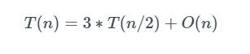
Karatsuba Algorithm
Time Complexity
Assuming that we replace two of the multiplications with only one makes the program faster.
Karatsuba improves the multiplication process by replacing the initial complexity from quadratic to
Where n is the number of digits of the numbers multiplying.
The Time Complexity of the algorithm can be represented as follows

Slide 81
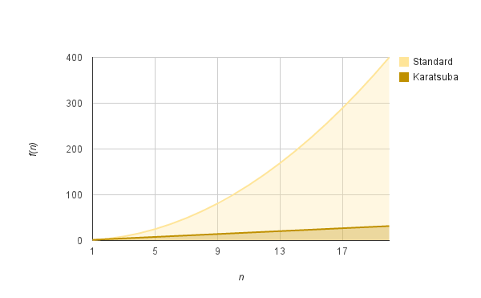
Karatsuba Algorithm
Time Complexity

Slide 82
Karatsuba Algorithm
Implementation
We shall look at implementing Karatsuba algorithm for four digits.
Algorithm
Compute starting set (a*c)
Compute set after starting set may it be ending set (b*d)
Compute starting set with ending sets
Subtract values of Step 3 from Step 2 from Step 1
Add all the values with the following modifcations:-
Pad up 4 zeros to the number obtained from Step 1
Step 2 value unchanged
Pad up two zeros to value obtained from Step 4.

Slide 83
Karatsuba Algorithm
Program
karatsuba1.java
Sample IO
Karatsuba Multiplication Algorithm Test
Enter two integer numbers:
24061994 28563
Product : 687282734622

Slide 84
Longest Sequence of 1s after flip
Introduction
In this program you are assumed to have a sequence of bits 0s and 1s
The sequence can be in the form of a binary string (“110011”) or as a binary array([1,0,1,1])
Given that you can flip any one bits in the sequence, you have to do it such that you get the longest sequence of 1s.

Slide 85
Longest Sequence of 1s after flip
Example
Consider the sequence 11011101111
To get the longest sequence of bits, out of all the possible flips, flipping the highlighted digit in the sequence 11011101111.
This will yield the following sequence: 11011111111
The output of the program would be 8 since there are 8 consecutive bits in the sequence
Additionally you may be given with a decimal which you would have to convert to a bit string to apply the algorithm too

Slide 86
Longest Sequence of 1s after flip
Solution
Given a number, provide the longest sequence of 1s after a flip of its bit sequence.
A simple solution is to store the binary representation of a given number in a binary array.
An efficient solution is to walk through the bits in the binary representation of the given number.
We keep track of the current 1’s sequence length and the previous 1’s sequence length. When we see a zero, update the previous Length:
If the next bit is a 1, the previous Length should be set to the current Length.
If the next bit is a 0, then we can’t merge these sequences together. So, set the previous Length to 0.
We update max length by comparing the following two:
The current value of max-length
Current-Length + Previous-Length .
Result = return max-length+1 (// add 1 for flip bit count )

Slide 87
Longest Sequence of 1s after flip
Program
bitflip1.java
Sample IO
Enter a number: 13
Answer is: 4
Enter a number: 1775
Answer is: 8
Enter a number: 15
Answer is: 5
Time Complexity: O(n)
Where n is the number of bits

Slide 88
Longest Sequence of 1s after flip
Program
bitflip2.java, bitflip3.java
Given a binary array nums and an integer k, return the maximum number of consecutive 1's in the array if you can flip at most k 0's.
Sample IO
Input: nums = [1,1,1,0,0,0,1,1,1,1,0], k = 2
Output: 6
Explanation: [1,1,1,0,0,1,1,1,1,1,1]
Bolded numbers were flipped from 0 to 1. The longest subarray is underlined.
Input: nums = [0,0,1,1,0,0,1,1,1,0,1,1,0,0,0,1,1,1,1], k = 3
Output: 10
Explanation: [0,0,1,1,1,1,1,1,1,1,1,1,0,0,0,1,1,1,1]
Bolded numbers were flipped from 0 to 1. The longest subarray is underlined.
Time Complexity: O(n)
Where n is the number of bits

Slide 89
Swap two nibbles in a byte
Introduction
A nibble consists of four bits. It is a four-bit aggregation, or half an octet.
There are two nibbles in a byte.
For example, 64 is to be represented as 01000000 in a byte (or 8 bits). The two nibbles are (0100) and (0000).
Nibble Swap
Suppose you have a number say 100.
100 is to be represented as 01100100 in a byte (or 8 bits)
The two nibbles are 0110 and 0100.
After swapping the nibbles, we get 01000110 which is 70 in decimal.
To swap the nibbles, We will use bitwise operators &, |, << and >> to swap the nibbles in a byte.

Slide 90
Swap two nibbles in a byte
Procedure
The snippet of code for nibble swap is as follows:
(x & 0x0F) << 4 | (x & 0xF0) >> 4
Explanation
As we know binary of 100 is 01100100. To swap the nibble we split the operation in two parts, in first part we get last 4 bits and in second part we get first 4 bit of a byte.
First operation: The expression “data & 0x0F” gives us the last 4 bits of data and result would be 00000100.
Using bitwise left shift operator ‘<<‘, we shift the last four bits to the left 4 times and make the new last four bits as 0. The result after the shift is 01000000.
Second operation: The expression “data & 0xF0” gives us first four bits of data and result would be 01100000.
Using bitwise right shift operator ‘>>’ , we shift the digit to the right 4 times and make the first four bits as 0. The result after the shift is 00000110.
After completing the two operation we use the bitwise OR ‘|’ operation on them. After OR operation you will find that first nibble to the place of last nibble and last nibble to the place of first nibble

Slide 91
Swap two nibbles in a byte
Program
nibble1.java
Sample IO
Input: 100
Output: 70
Input: 200
Output: 140
Input: 67
Output: 52

Slide 92
Block Swap Algorithm
Introduction
The block swap algorithm for array rotation is an efficient algorithm that is used for array rotation.
It can do the work in O(n) time complexity
We would be be given an array arr of size n, and an integer d
One would have to rotate the array arr by d elements
We have both recursive and interative versions of the algorithms

Slide 93
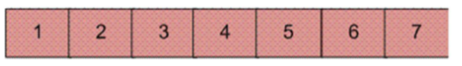
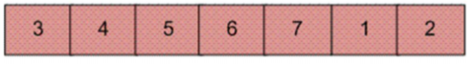
Block Swap Algorithm
Demo
Write an algorithm to rotate the following array by 2

Slide 94
Block Swap Algorithm
Algorithm
Initialize A = arr[0..d-1] and B = arr[d..n-1]
1) Do following until size of A is equal to size of B
a) If A is shorter, divide B into Bl and Br such that Br is of same
length as A. Swap A and Br to change ABlBr into BrBlA. Now A
is at its final place, so recur on pieces of B.
b) If A is longer, divide A into Al and Ar such that Al is of same
length as B Swap Al and B to change AlArB into BArAl. Now B
is at its final place, so recur on pieces of A.
2) Finally when A and B are of equal size, block swap them.

Slide 95
Block Swap Algorithm
Programs
blockswap1.java
blockswap2.java

Slide 96
Maximum Product Subarray
Subarray vs Subsequence
Subsequence: A subsequence is a sequence that can be derived from another sequence by zero or more elements, without changing the order of the remaining elements.
Subarray: A subarray is a contiguous part of array. An array that is inside another array.
A Subsequence cannot be a subarray
For instance, let arr = [1,2,3,4,5]
Examples for Subarrays: [1], [1,2], [2,3,4] etc
Examples for Subsequences: [1], [1,3], [1,2,3], [2,3,4]

Slide 97
Maximum Product Subarray
Introduction
You would be given a array of integers and you have to find a subarray which has the largest product
The array can contain both positive and negative integers
As discussed earlier -- A subarray is a contiguous subsequence of the array.
The solution must should be preferably having O(n) time complexity and constant space complexity

Slide 98
Maximum Product Subarray
Examples
Example-1
Input: nums = [2,3,-2,4]
Output: 6
Explanation: [2,3] has the largest product 6.
Example-2
Input: nums = [-2,0,-1]
Output: 0
Explanation: The result cannot be 2, because [-2,-1] is not a subarray.
Example-3
Input: nums = [6, -3, -10, 0, 2]
Output: 180
Explanation: The subarray is [6, -3, -10] with largest product as 180

Slide 99
Maximum Product Subarray
Program
mps1.java
This solution is a naive solution. The idea is to traverse over every contiguous subarrays, find the product of each of these subarrays and return the maximum product from these results.
Constraints:
Time Complexity: O(N^2)
Auxiliary Space: O(1)

Slide 100
Maximum Product Subarray
Program
mps2.java
This solution is an improvement to the previous naive solution.
It achieves the goal of linear time complexity constraint
Constraints:
Time Complexity: O(N)
Auxiliary Space: O(1)

Slide 101

Maximum sum of hourglass in matrix
Introduction
In this problem, we are given a 2D array (matrix) of any order.
Our task is to create a program that finds the maximum sum of the
hourglass.
Out of all the possible hourglass sums of a given m*n ordered matrix,
we have to print the maximum of all the sums
In our problem, Hourglass is a 7 element shape made in the matrix
in the following form:
X X X
X
X X X

Slide 102
Maximum sum of hourglass in matrix
Example
Consider the matrix:-
2 4 0 0
0 1 1 0
4 2 1 0
0 3 0 1
The hourglasses are :
2 4 0 0 1 1
1 2
4 2 1 0 3 0
4 0 0 1 1 0
1 1
2 1 0 3 0 1
So, an hourglass can be created using the following indexes:-
matrix[i][j] matrix[i][j+1] matrix[i][j+2]
matrix[i+1][j+1]
matrix[i+2][j] matrix[i+2][j+1] matrix[i+2][j+2]
We will find the sum of all these elements of the array from [0][0] to [R2][C-2] starting points. And the find the maxSum for all these hourglasses created from array elements.

Slide 103
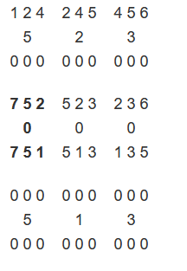
Maximum sum of hourglass in matrix
Program
hourglass1.java
The first line contains m and n which are the number of rows and columns of the matrix.
The next m lines contain n space seperated integers which are the elements of the matrix
Test Cases Explanation
Input All the possible hourglasses are given. The bold
5 5 hourglass is the one with the maximum sum.
1 2 4 5 6
7 5 2 3 6
0 0 0 0 0
7 5 1 3 5
0 0 0 0 0
Output
27

Slide 104
Maximum equilibrium sum in an array
Introduction
You have been given an array arr[]
Your task is to find maximum value of prefix sum which is also suffix sum for index i in arr[].
Example:
arr[] = {1, 2, 3, 5, 3, 2, 1}, then output is 11 as:-
Prefix sum = arr[0..3] = 1 + 2 + 3 + 5 = 11
Suffix sum = arr[3..6] = 5 + 3 + 2 + 1 = 11

Slide 105
Maximum equilibrium sum in an array
Program: Simple Approach
maxeqsum1.java
Check one by one the given condition (prefix sum equal to suffix sum) for every element and returns the element that satisfies the given condition with maximum value.
Time Complexity: O(n^2)
Auxiliary Space Complexity: O(n)
Sample IO #1
Input
arr[] = {-1, 2, 3, 0, 3, 2, -1}
Output
4
Explanation
Prefix sum of arr[0..3] = Suffix sum of arr[3..6]
Sample IO #2
Input
arr[] ={-2, 5, 3, 1, 2, 6, -4, 2}
Output
7
Explanation
Prefix sum of arr[0..3] = Suffix sum of arr[3..7]

Slide 106
Maximum equilibrium sum in an array
Better Approach: Algorithm
Traverse the array and store prefix sum for each index in array presum[], in which presum[i] stores sum of subarray arr[0..i]
Traverse array again and store suffix sum in another array suffsum[], in which suffsum[i] stores sum of subarray arr[i..n-1]
For each index check if presum[i] is equal to suffsum[i] and if they are equal then compare, there value with overall maximum so far

Slide 107
Maximum equilibrium sum in an array
Program: Better Approach
maxeqsum2.java
Based on the algorithm introduced earlier
Time Complexity: O(n)
Auxiliary Space Complexity: O(n)
Sample IO #1
Input
arr[] = {-1, 2, 3, 0, 3, 2, -1}
Output
4
Explanation
Prefix sum of arr[0..3] = Suffix sum of arr[3..6]
Sample IO #2
Input
arr[] ={-2, 5, 3, 1, 2, 6, -4, 2}
Output
7
Explanation
Prefix sum of arr[0..3] = Suffix sum of arr[3..7]

Slide 108
Maximum equilibrium sum in an array
Program: Even Better Approach
maxeqsum3.java
We can avoid the use of extra space by first computing the total sum, then using it to find the current prefix and suffix sums.
Time Complexity: O(n)
Auxiliary Space Complexity: O(n)
Sample IO #1
Input
arr[] = {-1, 2, 3, 0, 3, 2, -1}
Output
4
Explanation
Prefix sum of arr[0..3] = Suffix sum of arr[3..6]
Sample IO #2
Input
arr[] ={-2, 5, 3, 1, 2, 6, -4, 2}
Output
7
Explanation
Prefix sum of arr[0..3] = Suffix sum of arr[3..7]

Slide 109
Leaders in an array
Introduction
A leader in an array is an element which is greater than all the elements on its right side in the array.
There are two methods for finding leaders in an array.
Two types of elements are leaders by default.
Last element of an array is a leader by default because there is no element on the right side of it and so its right element is NULL.
Greatest element of an array is also a leader by default.

Slide 110
Leaders in an array
Example
Consider an array arr = {2,5,8,7,3,6}. The elements 6,7,8 are the leaders
6 - It is a leader by default because it is the last element of the array.
7 - It is a leader because it is greater than the elements on its right, i.e., 3,6.
8 - It is also a leader because it is greater than all the elements on its right, i.e., 7,3,6.

Slide 111
Leaders in an array
Program: Easy Method
leader1.java
Use two loops. The outer loop runs from 0 to size – 1 and one by one picks all elements from left to right.
The inner loop compares the picked element to all the elements to its right side. If the picked element is greater than all the elements to its right side, then the picked element is the leader.
Time Complexity: O(n*n)

Slide 112
Leaders in an array
Program: Easy Method
leader1.java
Test Case #1
Input
n = 6
A[] = {16,17,4,3,5,2}
Output
17 5 2
Explanation of TC#1
The first leader is 17 as it is greater than all the elements to its right. Similarly, the next leader is 5. The right most element is always a leader so it is also included.
Test Case #2
Input
n = 5
A[] = {1,2,3,4,0}
Output
4 0

Slide 113
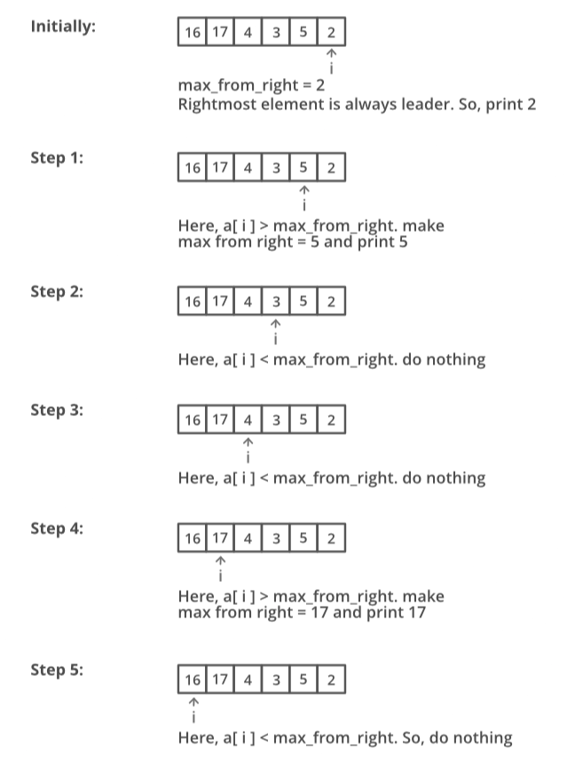
Leaders in an array
A Better Method

Slide 114
Leaders in an array
Program: Better Method
leader2.java
Scan all the elements from right to left in an array and keep track of maximum till now. When maximum changes its value, print it.
Time Complexity
O(n)

Slide 115
Majority element
Introduction
You are given an array of integers. The task is to print the majority element.
A majority element in an array arr[] of size n is an element that appears more than n/2 times.
Thus there can only be utmost only one majority element.
Example:
arr[] = {3, 3, 4, 2, 4, 4, 2, 4, 4}
Majority Element: 4
arr[] = {3, 3, 4, 2, 4, 4, 2, 4}
Majority Element: null

Slide 116
Majority element
Trivial Solution
The basic solution is to have two loops and keep track of the maximum count for all different elements.
If maximum count becomes greater than n/2, then break the loops and return the element having maximum count.
If the maximum count doesn’t become more than n/2 then the majority element doesn’t exist.

Slide 117
Majority element
Trivial Solution: Algorithm
Create a variable to store the max count, count = 0
Traverse through the array from start to end.
For every element in the array run another loop to find the count of similar elements in the given array.
If the count is greater than the max count update the max count and store the index in another variable.
If the maximum count is greater than the half the size of the array, print the element. Else print there is no majority element.

Slide 118
Majority element
Program: Trivial Solution
majele1.java
Time Complexity: O(n*n)
Auxiliary Space: O(1)
Notes:
// a sentinel value: https://stackoverflow.com/questions/21666508/can-someone-explain-to-me-what-a-sentinel-does-in-java-or-how-it-works

Slide 119
Majority element
BST Solution
Insert elements in Binary Search Tree (BST) one by one and if an element is already present then increment the count of the node. At any stage, if the count of a node becomes more than n/2 then return.
Algorithm
Create a binary search tree, if same element is entered in the binary search tree the frequency of the node is increased.
traverse the array and insert the element in the binary search tree.
If the maximum frequency of any node is greater than the half the size of the array, then perform a inorder traversal and find the node with frequency greater than half
Else print No majority Element.
Notes:
NOTE: YOU CAN SKIP THIS IF YOU HAVE TIME CONSTRAINTS

Slide 120
Majority element
Program: BST Solution
majele2.java
Time Complexity: O(n^2) in case of BST or O(nlogn) in case of balanced BT
Auxiliary Space: O(n)
Notes:
NOTE: YOU CAN SKIP THIS IF YOU HAVE TIME CONSTRAINTS

Slide 121
Majority element
Linear Solution
In Hashmap(key-value pair), at value, maintain a count for each element(key) and whenever the count is greater than half of the array length, return that key(majority element).
Algorithm
Create a hashmap to store a key-value pair, i.e. element-frequency pair.
Traverse the array from start to end.
For every element in the array, insert the element in the hashmap if the element does not exist as key, else fetch the value of the key ( array[i] ), and increase the value by 1
If the count is greater than half then print the majority element and break.
If no majority element is found print “No Majority element”

Slide 122
Majority element
Program: Linear Solution
majele3.java
Time Complexity: O(n)
Auxiliary Space: O(n)

Slide 123
Majority element
Boyre-Moore Solution: Two step process
The first step gives the element that maybe the majority element in the array. If there is a majority element in an array, then this step will definitely return majority element, otherwise, it will return candidate for majority element.
Check if the element obtained from the above step is majority element. This step is necessary as there might be no majority element.
Algorithm
Initialize an element m and a counter i = 0
for each element x of the input sequence:
if i = 0, then
assign m = x and i = 1
else
if m = x, then assign i = i + 1
else
assign i = i – 1
return m

Slide 124
Majority element
Program: Boyer-Moore Solution
majele4.java
Time Complexity: O(n)
Auxiliary Space: O(n)

Slide 125
Lexicographically first palindromic string
Introduction
Imagine you have been given a string s of alphabets
The task is to rearrange the characters of the given string to form a lexicographically first palindromic string
Lexicographically First/Lexicographically Minimum
String x is lexicographically less than string y
If either x is a prefix of y (and x ≠ y) or
There exists such i (1 ≤ i ≤ min(|x|, |y|)), that xi < yi, and for any j (1 ≤ j < i) xj = yj
The lexicographic comparison of strings is implemented by operator < in modern programming languages​​.
Notes:
|a| is the length of the string a

Slide 126
Lexicographically first palindromic string
Example
Our output string must be lexicographically minimum or lexicographically first.
Sample Input
str = “aabcc”
Sample Output
acbca
Print -1 if there are no such lexicographically minimum substring.
Notes:
|a| is the length of the string a

Slide 127
Lexicographically first palindromic string
Simple Approach
1. Sort the string characters in alphabetical(ascending) order.
2. One be one find lexicographically next permutation of the given string.
3. The first permutation which is palindrome is the answer.
Notes:
|a| is the length of the string a

Slide 128
Lexicographically first palindromic string
Improved Approach
We know that, In a palindrome of odd characters (Eg. “actac”, there will be only one character with frequency = 1, all others will have a frequency of 2)
In a Palindrome of even characters (“aacc”, all characters will have a frequency of 2)
Hence, we shall modify the algorithm as shown below
1. If length of string is even, then the frequency of each character in the string must be even.
2. If the length is odd then there should be one character whose frequency is odd and all other chars must have even frequency and at-least one occurrence of the odd character must be present in the middle of the string.

Slide 129
Lexicographically first palindromic string
Algorithm
1. Store frequency of each character in the given string
2. Check whether a palindromic string can be formed or not using the properties of palindromic string mentioned above.
3. If palindromic string cannot be formed, return “No Palindromic String”.
4. Else we create three strings and then return front_str + odd_str + rear_str.
Note that:-
odd_str : It is empty if there is no character with odd frequency. Else it contains all occurrences of odd character.
front_str : Contains half occurrences of all even occurring characters of string in increasing order.
rear_str Contains half occurrences of all even occurring characters of string in reverse order of front_str.

Slide 130
Lexicographically first palindromic string
Program
lexfirstpal.java
Time Complexity: O(n)
Auxillary Space Complexity: constant

Slide 131
Natural Sort Order
Introduction
Natural sorting is the sorting of text that does more than rely on the order of individual characters codes to make the finding of individual strings easier for a human reader.
Example
In alphabetical sorting, "z11" would be sorted before "z2" because the "1" in the first string is sorted as smaller than "2", while in natural sorting "z2" is sorted before "z11" because "2" is treated as smaller than "11".

Slide 132
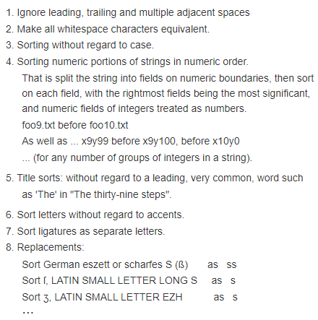
Natural Sort Order
Rules
There is no "one true way" to do this, but for the purpose of this task 'natural' orderings might include:

Slide 133
Natural Sort Order
Rules - Simplified
Alphabetical sorting:
z11
z2
Natural sorting:
z2
z11
During the 1996 MacHack conference, the Natural Order Mac OS System Extension was conceived and implemented overnight on-site as an entry for the Best Hack contest.
Dave Koelle wrote the Alphanum Algorithm in 1997 and Martin Pool published Natural Order String Comparison in 2000.

Slide 134
Natural Sort Order
Program
naturalorder1.java

Slide 135
Selection Sort
Introduction
The selection sort algorithm sorts an array by repeatedly finding the minimum element (considering ascending order) from unsorted part and putting it at the beginning.
The algorithm maintains two sub arrays in a given array.
The sub array which is already sorted.
2) Remaining sub array which is unsorted.
Notes:
In every iteration of selection sort, the minimum element (considering ascending order) from the unsorted subarray is picked and moved to the sorted subarray.

Slide 136
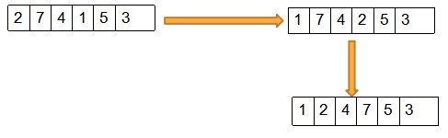
Selection Sort
Example:
arr[] = {2,7,4,1,5,3}
Notes:
In every iteration of selection sort, the minimum element (considering ascending order) from the unsorted subarray is picked and moved to the sorted subarray.

Slide 137
Selection Sort
Details
Time Complexity:T(n) = O(n*2)
Auxiliary Space: O(1)
Algorithmic Paradigm: Divide and Conquer
Sorting In Place: Yes
Stable: No

Slide 138
Merge Sort
Introduction
Merge Sort is a Divide and Conquer algorithm.
It divides input array in two halves, calls itself for the two halves and then merges the two sorted halves.
The merge() function is used for merging two halves. The merge(arr, l, m, r) is key process that assumes that arr[l..m] and arr[m+1..r] are sorted and merges the two sorted sub-arrays into one

Slide 139
Merge Sort
Algorithm: MergeSort(arr[], l, r)
If r > l
1. Find the middle point to divide the array into two halves:
middle m = (l+r)/2
2. Call mergeSort for first half:
Call mergeSort(arr, l, m)
3. Call mergeSort for second half:
Call mergeSort(arr, m+1, r)
4. Merge the two halves sorted in step 2 and 3:
Call merge(arr, l, m, r)

Slide 140
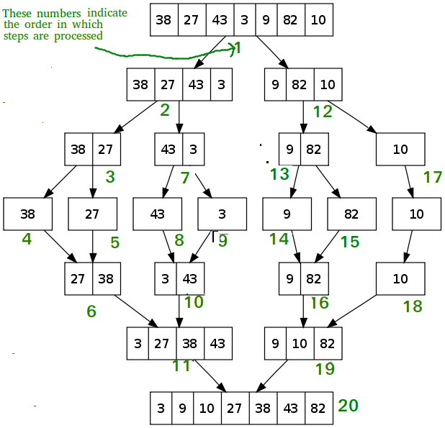
Merge Sort

Slide 141
Merge Sort
Details
Time Complexity:T(n) = 2T(n/2) + θ(n)
Auxiliary Space: O(1)
Algorithmic Paradigm: Divide and Conquer
Sorting In Place: No in a typical implementation
Stable: Yes

Slide 142
Quick Sort
Introduction
Like Merge Sort, QuickSort is a Divide and Conquer algorithm.
Picks an element as pivot and partitions the given array around the picked pivot.
/* low --> Starting index, high --> Ending index */
quickSort(arr[], low, high)
{
if (low < high)
{
/* pi is partitioning index, arr[pi] is now
at right place */
pi = partition(arr, low, high);
quickSort(arr, low, pi - 1); // Before pi
quickSort(arr, pi + 1, high); // After pi
}
}

Slide 143
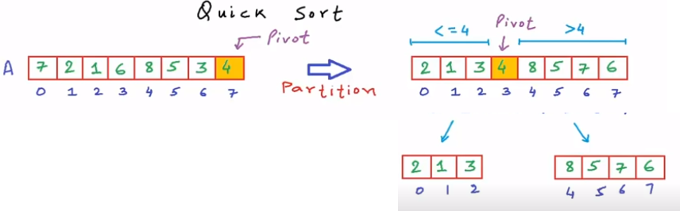
Quick Sort

Slide 144
Quick Sort
Details
Analysis of QuickSort Time taken by QuickSort in general can be written as following.
T(n) = T(k) + T(n-k-1) + (n)
Time Complexity: O(n*2)
Auxiliary Space: O(1)
Boundary Cases: Insertion sort takes maximum time to sort if elements are sorted in reverse order. And it takes minimum time (Order of n) when elements are already sorted.
Algorithmic Paradigm: Incremental Approach
Sorting In Place: Yes

Slide 145
Quick Sort
Programs
selectionsort.java
mergesort.java
quicksort.java

Slide 146
Weighted Substring
Introduction
Given a string P consisting of small English letters and a string Q consisting of weight of all characters of English alphabet
Each alphabet will have a weight w where 0<= w <=9
The task is to find the total numbers of unique substring with sum of weights atmost K.
Weight of a string s can be defined as
Weight[S[0]]+Weight[S[1]]+Weight[S[2]]......+Weight[S[Len-1]] where Len is length of string.

Slide 147
Weighted Substring
Examples
Sample IO #1
Input
P = “ababab”, Q = “12345678912345678912345678”, K = 5
Output
7
Explanation
The substrings with the sum of weights of individual characters ≤ 5 are:
“a”, “ab”, “b”, “bc”, “c”, “d”, “e”
The idea is to use HashSet to solve it
Sample IO #2
Input
P = “acbacbacaa”, Q = “12300045600078900012345000”, K = 2
Output
3
Explanation
The substrings with the sum of weights of individual characters ≤ 2 are:
“a”, “b”, “aa”

Slide 148
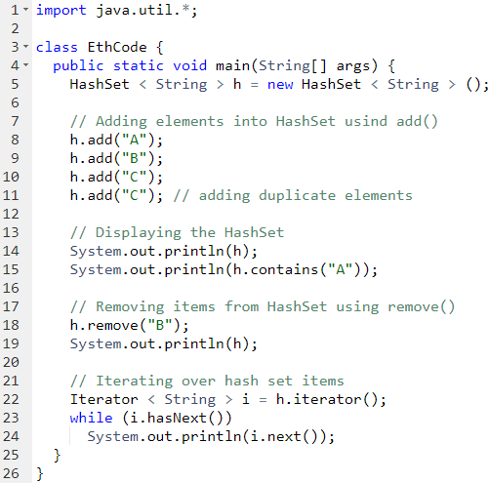
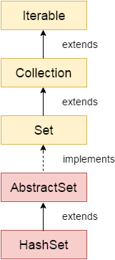
HashSet (For Weighted Substring)
Introduction
HashSet class is used to create a collection that uses a hash table for storage.
A Set contains unique elements only.
The underlying data structure for HashSet is Hashtable.
As it implements the Set Interface, duplicate values are not allowed.
Objects that you insert in HashSet are not guaranteed to be inserted in the same order as they are inserted based on their hash code.
Example
Output
[A, B, C]
true
[A,C]
A
C

Slide 149
Weighted Substring
Algorithm
1. Iterate over all the substrings using the nested loops and maintain the sum of the weight of all the characters encountered so far.
2. If the sum of characters is not greater than K, then insert it in a hashmap.
3. Finally, output the size of the hashmap.

Slide 150
Weighted Substring
Program
weightedsubstring1.java
Time Complexity: Quadratic a.k.a. O(n*n)

Slide 151

Weighted Substring
Introduction: Variation
This is the variation of the previous program
Given string S which contains only lowercase characters and an integer K
You have to find number of substrings having weight equal to K
Sample IO #1
Input
str=”abcdef”, K=5
Output
2
Sample IO #2
Input
str=”abcdef”, K=4
Output
1

Slide 152
Weighted Substring
Program
weightedsubstring2.java
Time Complexity: Quadratic a.k.a. O(n*n)

Slide 153
Move hyphen to the beginning
Introduction
You are given a string that has set of words and hyphens
Write a program to move all hyphens to front of string
The condition is that you have to do it by traversing the string only once.
Examples:
“hello-world-” becomes “--helloworld”
“I - love--Java” becomes “---I loveJava”

Slide 154
Move hyphen to the beginning
Approach-1: Using Swap
1. Initialize two indices i and j for traversals from beginning to end
2. If the current index contains hyphen, swap chars in index i with index j
3. Decrement the value by 1 and continue the advancement of j
4. At the end of this method, all hyphens will bubble up to the beginning

Slide 155
Move hyphen to the beginning
Program
movhyptobegin1.java
Time complexity: O(n)
Auxiliary Space: O(1)

Slide 156
Move hyphen to the beginning
Approach-2: Not Using Swap
The idea is to copy all characters except hyphen to the end
Copy the hyphens at the end.

Slide 157
Move hyphen to the beginning
Program
movhyptobegin2.java
Time complexity: O(n)
Auxiliary Space: O(1)

Slide 158
Manacher’s Algorithm
Introduction
Given a string, find the longest substring which is palindrome.
Here, the task is to find the Longest Palindromic Substring given a string
Manacher’s algorithm solves this task in Linear Time
Examples
if the given string is “abaaba”, the output should be “abaaba”
if the given string is “abababa”, the output should be “abababa”

Slide 159
Manacher’s Algorithm
Brute Force
The simple approach is to check each substring whether the substring is a palindrome or not.
To do this first, run three nested loops:-
The outer two loops pick all substrings one by one by fixing the corner characters
The inner loop checks whether the picked substring is palindrome or not.

Slide 160
Manacher’s Algorithm
Program
manacher1.java
Time complexity: O(n^3)
Auxiliary Space: O(1)

Slide 161
Manacher’s Algorithm
Better Solution
The idea is to generate all even length and odd length palindromes and keep track of the longest palindrome seen so far.
To generate odd length palindrome, Fix a center and expand in both directions for longer palindromes, i.e. fix i (index) as the center and two indices as i1 = i+1 and i2 = i-1
Compare i1 and i2 if equal then decrease i2 and increase i1 and find the maximum length.
Use a similar technique to find the even-length palindrome.
Take two indices i1 = i and i2 = i-1 and compare characters at i1 and i2 and find the maximum length till all pairs of compared characters are equal and store the maximum length.
Print the maximum length.

Slide 162
Manacher’s Algorithm
Program
manacher2.java
TC: Two nested traversals are needed.
SC: Matrix of size n*n is needed to store the dp array.
Time complexity: O(n^2)
Auxiliary Space: O(1)

Slide 163
Manacher’s Algorithm
Manacher Algorithm to the rescue!
Manacher’s Algorithm helps us find the longest palindromic substring in the given string.
It optimizes over the brute force solution by using some insights into how palindromes work

Slide 164
Manacher’s Algorithm
Notations
Let’s focus on odd length palindromes for simplicity
Let c be the center of the longest length palindrome we have encountered till now.
Let l and r be the left and right boundaries of this palindrome, i.e., the left-most character index and the right-most character index respectively.
Now, let’s take an example to understand c, l, and r

Slide 165


Manacher’s Algorithm
Algorithm. Take an example “abacabacabb”
When going from left to right, when i is at index 1, the longest palindromic substring is “aba” (length = 3)
The answer for the given string is 9 when the palindrome is centered at index 5; c, l, and r are as follows:

Slide 166


Manacher’s Algorithm
Concept: Mirror Index
For any palindrome centered at a center c, the mirror of index j is j’ such that
For palindrome “abacaba”, the mirror of j is j’ and the mirror of j’ is j.
Now, come back to the algorithm

Slide 167
Manacher’s Algorithm
Algorithm Continued
When we move i from left to right, we try to “expand” the palindrome at each i.
Expand means,that we’ll check whether there exists a palindrome centered at i and if there exists one, we’ll store the “expansion length” to the left or to the right in a new array called P[] array or (some prefer) LPS[].
If the palindrome at i expands beyond the current right boundary r, then c is updated to i and new l, r are found and updated.

Slide 168

Manacher’s Algorithm
Example
Let’s take the previously discussed palindrome “abacaba” which is centered at i = 3.
Therefore, the P[] array stores the expansion
length of the palindrome centered at each index.
But we don’t need to manually go to each index and expand to check the expansion length every time.
This is exactly where Manacher’s algorithm optimizes better than brute force, by using some insights on how palindromes work.

Slide 169

Manacher’s Algorithm
Optimization explained
Remember that c indicates the center of the current longest odd length palindrome. And l, r denote the palindrome’s left and right boundaries
Let’s see the P[] array for the string
“abacaba”.
When i = 4, the index is inside the scope of the current longest palindrome, i.e., i < r.
So, instead of naively expanding at i, we want to know the minimum expansion length that is certainly possible at i, so that we can expand on that minimum P[i] and see, instead of doing from start. So, we check for mirror i’

Slide 170
Manacher’s Algorithm
Optimization
As long as the palindrome at index i’ does NOT expand beyond the left boundary (l) of the current longest palindrome, we can say that the minimum certainly possible expansion length at i is P[i’].
Remember that we are only talking about the minimum possible expansion length, the actual expansion length could be more and, we’ll find that out by expanding later on. In this case, P[4] = P[2] = 0. We try to expand but still, P[4] remains 0.
Now, if the palindrome at index i’ expands beyond the left boundary (l) of the current longest palindrome, we can say that the minimum certainly possible expansion length at i is r-i.

Slide 171


Manacher’s Algorithm
Example
So, P[4] = 5–4 = 1
You could ask but why can’t the palindrome centered at i expand after r in this case? If it did, then it would have already been covered with the current center c only. But, it didn’t. So, P[i] = r-i
If palindrome at i were to expand beyond r, then the character at index 6 should have been ‘a’. But if that were to happen, the current palindrome centered at c would NOT have been “cacac” but “acacaca”
So, we can sum the two quoted points above as the
image at the right:
Notes:
2nd Image Algo explanation:
See if the mirror of i is expanding beyond the left boundary of current longest palindrome at center c
if it is, then take r - i
else take P[mirror]

Slide 172
Manacher’s Algorithm
Algorithm Continued
Now the only thing left is to expand at i after P[i], so we check characters from index (P[i] + 1) and keep expanding at i.
If this palindrome expands beyond r, update c to i and r to (i + P[i]).
The P[] array is now filled and the maximum value in this array gives us the longest palindromic substring in the given string
This works for odd lengthed strings only. we simply append N + 1 special characters (say ‘#’) in between every two characters, just to make sure that our modified string is always of odd length.
Examples:
aba -> #a#b#a#
abba-> #a#b#b#a#

Slide 173
Manacher’s Algorithm
Program
manacher3.java
Time Complexity: O(N)
Space Complexity: O(N)

Slide 174
Sorted Unique Permutation
Introduction
In this programming problem, we are given a string str
We have to print the distinct sorted permutations of the string elements that can be formed.
Condition: The string may contain a character that will arise more than one time
Permutation is rearranging all the elements of a set based on a specific sequence or type. The set may be ordered or may not be ordered.

Slide 175
Sorted Unique Permutation
Example
Input
RST
Output
RST, RTS, SRT, STR, TRS, TSR
Explanation
From this string total 3! = 6 permutations can be formed.
Let’s fix R and find permutations from s and t. This will give 2 strings RST, RTS.
Similarly fixing S will give SRT, STR. And fixing T will give TRS, TSR.

Slide 176
Sorted Unique Permutation
A few more examples
Example-1
Input
BAC
Output
ABC ACB BAC BCA CAB CBA
Example-2
Input
AAB
Output
AAB ABA BAA
Example-3
Input
DBCA
Output
ABCD ABDC ACBD ACDB ADBC ADCB BACD BADC BCAD BCDA BDAC BDCA CABD CADB CBAD CBDA CDAB CDBA DABC DACB DBAC DBCA DCAB DCBA

Slide 177
Sorted Unique Permutation
For repetitions
Input
AAL
Output
AAL ALA LAA
Explanation
Length of Str: 3
A is repeated 2 times: 3!/2 = 3

Slide 178
Sorted Unique Permutation
Algorithm
Sort the string, if the input isn’t sorted already
Obtain the total number of permutations which can be formed from that string
Print the sorted string and then loop for the number of (permutations-1) times as 1st string is already printed
Find the next greater string

Slide 179
Sorted Unique Permutation
Program
sup1.java
Time Complexity: O(P*Q), where P is the size of the string and Q is the number of permutations possible
Space Complexity: O(N)

Slide 180
Maneuvering Problem
Introduction
The problem is also called Maneuvering a Cave
You are given a m x n matrix as input
The task is to count all the possible paths from top left to bottom right of a m x n matrix
Constraints
You start from 0 x 0 and end at m-1 x n-1
From each cell you can either move only to right or down.

Slide 181
Sorted Unique Permutation
Examples
Input
m = 2, n = 2
Output
2
Explanation
There are two paths
(0, 0) -> (0, 1) -> (1, 1)
(0, 0) -> (1, 0) -> (1, 1)
Input
m = 2, n = 3
Output
3
Explanation
There are three paths
(0, 0) -> (0, 1) -> (0, 2) -> (1, 2)
(0, 0) -> (0, 1) -> (1, 1) -> (1, 2)
(0, 0) -> (1, 0) -> (1, 1) -> (1, 2)

Slide 182
Maneuvering Problem
Program
Solution-1
manCave1.java
Time Complexity: Exponential

Slide 183


Maneuvering Problem
Solution-2: DP
Dynamic Programming Properties
1) Overlapping Subproblems
a) Memoized (Top Down)
b) Tabulation (Bottom Up)
2) Optimal Substructure
Notes:
Optimal Substructure
Like Divide and Conquer, Dynamic Programming combines solutions to sub-problems. Dynamic Programming is mainly used when solutions of the same subproblems are needed again and again. In dynamic programming, computed solutions to subproblems are stored in a table so that these don’t have to be recomputed. So Dynamic Programming is not useful when there are no common (overlapping) subproblems because there is no point storing the solutions if they are not needed again. For example, Binary Search doesn’t have common subproblems. If we take an example of following recursive program for Fibonacci Numbers, there are many subproblems that are solved again and again.
We can see that the function fib(3) is being called 2 times. If we would have stored the value of fib(3), then instead of computing it again, we could have reused the old stored value. There are following two different ways to store the values so that these values can be reused:
a) Memoization (Top Down)
b) Tabulation (Bottom Up)
The memoized program for a problem is similar to the recursive version with a small modification that looks into a lookup table before computing solutions. We initialize a lookup array with all initial values as NIL. Whenever we need the solution to a subproblem, we first look into the lookup table. If the precomputed value is there then we return that value, otherwise, we calculate the value and put the result in the lookup table so that it can be reused later.
b) Tabulation (Bottom Up): The tabulated program for a given problem builds a table in bottom-up fashion and returns the last entry from the table. For example, for the same Fibonacci number, we first calculate fib(0) then fib(1) then fib(2) then fib(3), and so on. So literally, we are building the solutions of subproblems bottom-up.
Both Tabulated and Memoized store the solutions of subproblems. In Memoized version, table is filled on demand while in the Tabulated version, starting from the first entry, all entries are filled one by one. Unlike the Tabulated version, all entries of the lookup table are not necessarily filled in Memoized version.
Look at dp1.java and dp2.java for tabulated and memoized solutions of Fibonacci sequence
Optimal Substructure
A given problems has Optimal Substructure Property if optimal solution of the given problem can be obtained by using optimal solutions of its subproblems.
For example, the Shortest Path problem has following optimal substructure property:
If a node x lies in the shortest path from a source node u to destination node v then the shortest path from u to v is combination of shortest path from u to x and shortest path from x to v. The standard All Pair Shortest Path algorithm like Floyd–Warshall and Single Source Shortest path algorithm for negative weight edges like Bellman–Ford are typical examples of Dynamic Programming.
On the other hand, the Longest Path problem doesn’t have the Optimal Substructure property. Here by Longest Path we mean longest simple path (path without cycle) between two nodes. CONSIDER THE FIGURE of the graph There are two longest paths from q to t: q→r→t and q→s→t. Unlike shortest paths, these longest paths do not have the optimal substructure property. For example, the longest path q→r→t is not a combination of longest path from q to r and longest path from r to t, because the longest path from q to r is q→s→t→r and the longest path from r to t is r→q→s→t.

Slide 184

Maneuvering Problem

Slide 185
Maneuvering Problem
Program
Solution-2
manCave2.java
Time Complexity: O(mn)

Slide 186
Maneuvering Problem
Program
Solution-3
manCave3.java
This is an optimization over the DP variant of the problem
We will be using a 1D array here
Time Complexity: O(n)

Slide 187

Combinations
Introduction
A combination is a subset of elements from a given set
Example: In a card game, we have to deal 5 cards out of the pack consisting of 52 cards. We have no interest in the order in which the 5 cards were selected. Rather, we only care which cards are present in the hand
Program: Given an array of size n, generate and print all possible combinations of r elements in array. For example, if input array is {1, 2, 3, 4} and r is 2, then output should be {1, 2}, {1, 3}, {1, 4}, {2, 3}, {2, 4} and {3, 4}.

Slide 188
Combinations
Technique-1
We create a temporary array ‘data’ which stores all outputs one by one.
Start with the first index in data, one by one fix elements at this index and recur for remaining indexes.
Example: arr = [1, 2, 3, 4, 5] r = 3
We first fix 1 at index 0 in data then recur for remaining indexes, then we fix 2 at index 0 and recur.
Then we fix 3 and recur for remaining indexes
When number of elements in data becomes equal to r (size of a combination), we print data

Slide 189

Combinations
Technique-1

Slide 190
Combinations
Program
comb1.java
Time Complexity: O(n)

Slide 191
Combinations
Technique-1: Handling Duplicates
If input array is [1 , 2, 1] and r is 2, then the program prints [1, 2] and [2, 1] as two different combinations
We can avoid duplicates by adding following to our code
1) Add code to sort the array before calling combinationUtil() in printCombination()
2) Add following lines at the end of for loop in combinationUtil()

Slide 192
Combinations
Program
comb2.java
Time Complexity: O(n)

Slide 193

Combinations
Technique-2
The idea of technique-2 is similar to the subset-sum problem and is based on Pascal’s identity
We one by one consider every element of input array, and recur for two cases:
1) The element is included in current combination
(We put the element in data and increment next available index in data)
2) The element is excluded in current combination (We do not put the element and do not change index)

Slide 194
Combinations
Program
comb3.java
Time Complexity: O(n)

Slide 195
Josephus Problem
Introduction
This problem goes back to Josephus Flavius, a 1st century Roman historian
41 rebels are trapped in a cave, surrounded by enemy troops. They decide to commit suicide: they line up in a circle and systematically kill every other one, going around and around, until only one rebel is left -- who supposedly kills himself (fat chance).
Who is the lone survivor?

Slide 196
Josephus Problem
Introduction
This problem goes back to Josephus Flavius, a 1st century Roman historian
41 rebels are trapped in a cave, surrounded by enemy troops. They decide to commit suicide: they line up in a circle and systematically kill every other one, going around and around, until only one rebel is left -- who supposedly kills himself (fat chance).
Who is the lone survivor?

Slide 197
Josephus Problem
Task
Given the total number of persons n and a number k which indicates that k-1 persons are skipped and kth person is killed in circle.
The task is to choose the place in the initial circle so that you are the last one remaining and so survive.

Slide 198
Josephus Problem
Examples
n = 5 and k = 2
The safe position is 3. Firstly, the person at position 2 is killed, then person at position 4 is killed, then person at position 1 is killed. Finally, the person at position 5 is killed. So the person at position 3 survives
n = 7 and k = 3
The safe position is 4. The persons at positions 3, 6, 2, 7, 5, 1 are killed in order, and person at position 4 survives

Slide 199
Josephus Problem
Thinking
Clearly, we can represent the rebels by a list of numbers {1,2,...,41} and we can simulate the demise of the corresponding rebel by manipulating this list.
For example, we could just mark the dead rebels by switching item i to -i (a standard hack, and a true abuse of negative numbers).
Actually, it will be more interesting to generalize slightly: let us deal with the problem for an arbitrary number n of rebels.
So, our original list is {1,2,...,n} , and we have to make a n-1 deletions in the right place to find the survivor.

Slide 200
Josephus Problem
Structure
The problem has following recursive structure
josephus(n, k) = ( josephus(n - 1, k) + k-1 ) % n + 1
josephus(1, k) = 1
After the first person (kth from beginning) is killed, n-1 persons are left.
So we call josephus(n – 1, k) to get the position with n-1 persons.
But the position returned by josephus(n – 1, k) will consider the position starting from k%n + 1.
So, we must make adjustments to the position returned by josephus(n – 1, k).

Slide 201

Josephus Problem
Example
In the above image the execution starts from 2 and finally the free person will be 11.

Slide 202
Josephus Problem
Program
josephus1.java
IO Format
Input
n = 14; k = 2
Output
13
Explanation
The chosen place is 13
Time Complexity
O(n)

Slide 203
Josephus Problem
Another Solution
Let’s take an example of there are 5 people in a circle and execution starts clockwise at position 3
So there are five people – 1 2 3 4 5 and execution starts clockwise at position 3. Therefore if you kill 3 then are left with the list something like – 1 2 4 5.
Now again you have to kill the person at position 3 clockwise counting from the last killed person.

Slide 204
Josephus Problem
Another Solution
Now you need to execute the person at position 1. So executing the person at 1 you are left with the list 2 4 5.
After executing another person you get list 2 4.
Now you are left with 2 persons in the list. So you have to calculate the position wisely to execute the person.
Therefore the calculated position would be
(starting position of the execution)%(no of people remaining in the list less than starting position)
i.e. 3%2 = 1.
So finally the winner is 4.

Slide 205
Josephus Problem
Program
josephus2.java
IO Format
Input
n = 14; k = 2
Output
13
Explanation
The chosen place is 13
Time Complexity
O(n)

Slide 206
Maze Solving
Introduction to Backtracking
The Backtracking is an algorithmic-method to solve a problem with an additional way.
It uses a recursive approach to explain the problems.
We can say that the backtracking is needed to find all possible combination to solve an optimization problem.
Backtracking is a systematic way of trying out different sequences of decisions until we find one that "works."

Slide 207

Maze Solving
Introduction to Backtracking
In Backtracking, we "explore" each node, as follows:
Step 1 − if current point is a feasible solution, return success
Step 2 − else if all paths are exhausted (i.e current point is an end point), return failure, since we have no feasible solution.
Step 3 − else if current point is not an end point, backtrack and explore other points and repeat above steps.

Slide 208


Maze Solving
Introduction to Rat in a Maze
A Maze is given as N*N binary matrix of blocks where source block is the upper left most block maze[0][0] and destination block is lower rightmost block maze[N-1][N-1].
A rat starts from source and has to reach the destination. The rat can move only in two directions: forward and down.

Slide 209

Maze Solving
Introduction to Rat in a Maze
Representing the Maze on the left as the matrix given below
[1, 0, 0, 0
1, 1, 0, 1
0, 1, 0, 0
1, 1, 1, 1]
The Solution Matrix is given below where 1’s represent the path
[1, 0, 0, 0
1, 1, 0, 0
0, 1, 0, 0
0, 1, 1, 1]

Slide 210

Maze Solving
Approach
Form a recursive function, which will follow a path and check if the path reaches the destination or not.
If the path does not reach the destination then backtrack and try other paths.

Slide 211
Maze Solving
Algorithm
Create a solution matrix, initially filled with 0’s.
Create a recursive function, which takes initial matrix, output matrix and position of rat (i, j).
if the position is out of the matrix or the position is not valid then return.
Mark the position output[i][j] as 1 and check if the current position is destination or not. If destination is reached print the output matrix and return.
Recursively call for position (i+1, j) and (i, j+1).
Unmark position (i, j), i.e output[i][j] = 0.

Slide 212
Maze Solving
Program
ratinmaze1.java
Sample IO
Input
int maze[][] = { { 1, 0, 0, 0 },
{ 1, 1, 0, 1 },
{ 0, 1, 0, 0 },
{ 1, 1, 1, 1 } };
Output
1 0 0 0
1 1 0 0
0 1 0 0
0 1 1 1
Time Complexity
O(2^(n*n))
Explanation
The recursion can run upper-bound 2^(n*n) times.
Space Complexity
O(n*n)

Slide 213

N Queens Problem
Introduction
N Queens is another example problem that can be solved using Backtracking
The N Queens is the problem of placing N chess queens on an N×N chessboard so that no two queens attack each other
The solution can be a matrix indicating the position of the queens or the index numbers of the cells in whicb the queens have been placed

Slide 214
N-Queens Problem
Backtracking Method of solving
The idea is to place queens one by one in different columns, starting from the leftmost column.
When we place a queen in a column, we check for clashes with already placed queens.
In the current column, if we find a row for which there is no clash, we mark this row and column as part of the solution.
If we do not find such a row due to clashes then we backtrack and return false.

Slide 215
N-Queens Problem
Backtracking Algorithm
1) Start in the leftmost column
2) If all queens are placed return true
3) Try all rows in the current column.
Do following for every tried row.
a) If the queen can be placed safely in this row then mark this [row, column] as part of the solution and recursively check if placing queen here leads to a solution.
b) If placing the queen in [row, column] leads to a solution then return true.
c) If placing queen doesn't lead to a solution then unmark this [row, column] (Backtrack) and go to step (a) to try other rows.
3) If all rows have been tried and nothing worked, return false to trigger backtracking.

Slide 216

N-Queens Problem
Program
nqueens1.java
Sample IO
Input
8
Output

Slide 217
N-Queens Problem
Optimization
The idea is not to check every element in right and left diagonal instead use property of diagonals:
1. The sum of i and j is constant and unique for each right diagonal where i is the row of element and j is the column of element.
2. The difference of i and j is constant and unique for each left diagonal where i and j are row and column of element respectively.

Slide 218
N-Queens Problem
Program
nqueens2.java
The board size is fixed to 4 here.

Slide 219

A Knight’s Tour
Introuduction
A knight's tour is a sequence of moves of a knight on a chessboard such that the knight visits every square exactly once.
If the knight ends on a square that is one knight's move from the beginning square, the tour is closed; otherwise, it is open
The knight's tour problem is the problem of finding a knight's tour.

Slide 220
A Knight’s Tour
Problem
Given a N*N board with the Knight placed on the first block of an empty board.
Moving according to the rules of chess knight must visit each square exactly once.
Print the order of each cell in which they are visited.

Slide 221

A Knight’s Tour
An open knight's tour of a chessboard

Slide 222
A Knight’s Tour
Sample IO
Input
N = 8
Output
1 50 45 62 31 18 9 64
46 61 32 49 10 63 30 17
51 2 47 44 33 28 19 8
60 35 42 27 48 11 16 29
41 52 3 34 43 24 7 20
36 59 38 55 26 21 12 15
53 40 57 4 23 14 25 6
58 37 54 39 56 5 22 13
Explanation
The tour is started from the leftmost corner (marked as 1)

Slide 223

A Knight’s Tour
Naive Algorithm

Slide 224

A Knight’s Tour
Backtracking Algorithm

Slide 225

A Knight’s Tour
Program
knightstour1.java
The board size is fixed to 8 here
Output

Slide 226
Warnsdorff’s Algorithm
Problem
Warnsdorff’s algorithm for Knight’s tour problem
Same problem statement: A knight is placed on the first block of an empty board and, moving according to the rules of chess, must visit each square exactly once.
Warnsdorff's rule is a heuristic for finding a single knight's tour. The knight is moved so that it always proceeds to the square from which the knight will have the fewest onward moves.
When calculating the number of onward moves for each candidate square, we do not count moves that revisit any square already visited. It is possible to have two or more choices for which the number of onward moves is equal; there are various methods for breaking such ties

Slide 227
Warnsdorff’s Algorithm
Warnsdorff’s Rule
We can start from any initial position of the knight on the board.
We always move to an adjacent, unvisited square with minimal degree (minimum number of unvisited adjacent).
This algorithm may also more generally be applied to any graph.
Note:
A position Q is accessible from a position P if P can move to Q by a single Knight’s move, and Q has not yet been visited.
The accessibility of a position P is the number of positions accessible from P.

Slide 228
Warnsdorff’s Algorithm
Warnsdorff’s Rule: Algorithm
Set P to be a random initial position on the board
Mark the board at P with the move number “1”
Do following for each move number from 2 to the number of squares on the board:
let S be the set of positions accessible from P.
Set P to be the position in S with minimum accessibility
Mark the board at P with the current move number
Return the marked board — each square will be marked with the move number on which it is visited.

Slide 229
Warnsdorff’s Algorithm
Warnsdorff’s Rule: Algorithm
Set P to be a random initial position on the board
Mark the board at P with the move number “1”
Do following for each move number from 2 to the number of squares on the board:
let S be the set of positions accessible from P.
Set P to be the position in S with minimum accessibility
Mark the board at P with the current move number
Return the marked board — each square will be marked with the move number on which it is visited.

Slide 230
Warnsdorff’s Algorithm
Program
knightstour2.java
The board size is fixed to 8 here

Slide 231
Hamiltonian Cycle
Introduction
Hamiltonian Path in an undirected graph is a path that visits each vertex exactly once.
A Hamiltonian cycle (or Hamiltonian circuit) is a Hamiltonian Path such that there is an edge (in the graph) from the last vertex to the first vertex of the Hamiltonian Path.
The task is to determine whether a given graph contains Hamiltonian Cycle or not

Slide 232

Hamiltonian Cycle
IO Format
Input
Adjacency Matrix or Adjacency List representing the graph
If it is an adjacency matrix, it will be a 2D array with ‘1’ at (i,j) if there is a path from i to j.
Output
Array which represents the Hamiltonian Path
a -> Graph
b -> Adj. List
c- > Adj. Matrix

Slide 233

Hamiltonian Cycle
Example
Notes:
A Hamiltonian cycle around a network of six vertices

Slide 234
Hamiltonian Cycle
Backtracking Solution
Naive approach is to generate all possible configurations (n! configurations in total) of vertices and print a configuration that satisfies the given constraints.
A better approach is to use backtracking
Create an empty path array and add vertex 0 to it. Add other vertices, starting from the vertex 1.
Before adding a vertex, check for whether it is adjacent to the previously added vertex and not already added.
If we find such a vertex, we add the vertex as part of the solution. If we do not find a vertex then we return false.

Slide 235
Hamiltonian Cycle
Program
hamilt1.java
Sample IO
Input
8
0 1 0 1 1 0 0 0
1 0 1 0 0 1 0 0
0 1 0 1 0 0 1 0
1 0 1 0 0 0 0 1
1 0 0 0 0 1 0 1
0 1 0 0 1 0 1 0
0 0 1 0 0 1 0 1
0 0 0 1 1 0 1 0
Output
0 1 2 3 7 6 5 4 0
Explanation:
First line in input is the number of vertices
The next lines would be the matrix

Slide 236

Kruskal’s Algorithm
Minimum Spanning Tree
A minimum spanning tree (MST) or minimum weight spanning tree is a subset of the edges of a connected, edge-weighted undirected graph that connects all the vertices together, without any cycles and with the minimum possible total edge weight
A minimum spanning tree has (V – 1) edges where V is the number of vertices in the given graph.

Slide 237
Kruskal’s Algorithm
Algorithm to find MST
Sort all the edges in non-decreasing order of their weight.
Pick the smallest edge. Check if it forms a cycle with the spanning tree formed so far.
If cycle is not formed, include this edge.
Else discard it.
Repeat step-2 until there are (V-1) edges in the spanning tree.
Note: Step #2 uses the Union-Find algorithm to detect cycles.

Slide 238
Kruskal’s Algorithm
Algorithm to find MST
Sort all the edges in non-decreasing order of their weight.
Pick the smallest edge. Check if it forms a cycle with the spanning tree formed so far.
If cycle is not formed, include this edge.
Else discard it.
Repeat step-2 until there are (V-1) edges in the spanning tree.
Note: Step 2 uses the Union-Find algorithm to detect cycles.

Slide 239


Kruskal’s Algorithm
Algorithm in Action
Notes:
First image: Graph
Second Image: Steps involved in forming a MST

Slide 240
Union-Find and Disjoint-Set
Disjoint-Set data structure
A disjoint-set data structure that keeps track of a set of elements partitioned into a number of disjoint or non-overlapping subsets.
It provides near-constant-time operations to add new sets, to merge existing sets, and to determine whether elements are in the same set.
Plays a key role in Kruskal’s algorithm for finding the minimum spanning tree of a graph.
This can also be used to detect cycle in the graph.

Slide 241

Union-Find and Disjoint-Set
Disjoint-Set Construction
A disjoint-set forest consists of a number of elements each of which stores an id, a parent pointer
The parent pointers of elements are arranged to form one or more trees, each representing a set.
If an element’s parent pointer points to no other element, then the element is the root of a tree and is the representative member of its set.
A set may consist of only a single element. However, if the element has a parent, the element is part of whatever set is identified by following the chain of parents upwards until a representative element (one without a parent) is reached at the root of the tree.

Slide 242

Union-Find and Disjoint-Set
Disjoint-Set Operations
The sets shown at the right are disjoint because they have no members in common.
Union-Find supports three basic operations:
Find(A): Determine which subset an element A is in. For example, find(d) would return the subset [ g, d, c ].
Union(A, B): Join two subsets that contain A and B into a single subset. For example, union(d, j) would combine [ g, d, c ] and [ i, j ] into the larger set [ g, d, c, i, j ].
AddSet(A): Add a new subset containing just that element A. For example, addSet(h) would add a new set [ h ].

Slide 243

Union-Find and Disjoint-Set
Program
disjset1.java
Sample IO
Input
Output
Set Id: 0 elements: [0, 1, 2, 3]
Set Id: 4 elements: [4, 5]
Explanation:
The Graph is input to the program and it provides a disjoint set output

Slide 244
Kruskal’s Algorithm
Disjoint-Set data structure
A disjoint-set data structure that keeps track of a set of elements partitioned into a number of disjoint or non-overlapping subsets.
It provides near-constant-time operations to add new sets, to merge existing sets, and to determine whether elements are in the same set.
Plays a key role in Kruskal’s algorithm for finding the minimum spanning tree of a graph.
This can also be used to detect cycle in the graph.

Slide 245

Kruskal’s Algorithm
Algorithm in Action: Another Example

Slide 246

Kruskal’s Algorithm

Slide 247

Kruskal’s Algorithm
Program
kruskal1.java
Sample IO
Input
Output
Following are the edges in the constructed MST
2 -- 3 == 4
0 -- 3 == 5
0 -- 1 == 10
Minimum Cost Spanning Tree: 19
Time Complexity
O(ELogE)

Slide 248
Greedy Algorithms
Introduction
A greedy algorithm is any algorithm that follows the problem-solving heuristic of making the locally optimal choice at each stage
In many problems, a greedy strategy does not produce an optimal solution, but a greedy heuristic can yield locally optimal solutions that approximate a globally optimal solution in a reasonable amount of time.
Example: In Travelling Sales Problem, the heuristic is "At each step of the journey, visit the nearest unvisited city."
This problem has unreasonably many steps and greedy approach limits them

Slide 249

Greedy Algorithms
Example
Greedy algorithms determine the minimum number of coins to give while making change.
The image represents the steps most people would take to emulate a greedy algorithm to represent 36 cents using only coins with values {1, 5, 10, 20}.
The coin of the highest value, less than the remaining change owed, is the local optimum.

Slide 250
Greedy Algorithms
Properties
Greedy Algorithm solves problems by making the best choice that seems best at the particular moment.
A greedy algorithm works if a problem exhibits the following two properties:
1. Greedy Choice Property: A globally optimal solution can be reached at by creating a locally optimal solution. In other words, an optimal solution can be obtained by creating "greedy" choices.
2. Optimal substructure: Optimal solutions contain optimal subsolutions. In other words, answers to subproblems of an optimal solution are optimal.

Slide 251
Activity Selection Problem
Introduction
Recap: At every step, we can make a choice that looks best at the moment, and we get the optimal solution of the complete problem.
Activity Selection Problem is a fine example of a Greedy Algorithm
Problem Statement: You are given n activities with their start and finish times. Select the maximum number of activities that can be performed by a single person, assuming that a person can only work on a single activity at a time.

Slide 252
Activity Selection Problem
Examples
Consider the following examples
Input
start[] = {10, 12, 20};
finish[] = {20, 25, 30};
Output
{0,2}
Explanation
A person can perform at most two activities. The maximum set of activities that can be executed is {0, 2}
These are indexes in start[] and finish[]
Input
start[] = {1, 3, 0, 5, 8, 5};
finish[] = {2, 4, 6, 7, 9, 9};
Output
{0, 1, 3, 4}
Explanation
A person can perform at most four activities. The maximum set of activities that can be executed is {0, 1, 3, 4}

Slide 253
Activity Selection Problem
Algorithm
The greedy choice is to always pick the next activity whose finish time is least among the remaining activities and the start time is more than or equal to the finish time of the previously selected activity.
1) Sort the activities according to their finishing time
2) Select the first activity from the sorted array and print it.
3) Do the following for the remaining activities in the sorted array.
If the start time of this activity is greater than or equal to the finish time of the previously selected activity then select this activity and print it.

Slide 254

Activity Selection Problem

Slide 255
Activity Selection Problem
Program
actsel1.java
Activities are sorted here
Sample IO
Input
start = {1, 3, 0, 5, 8, 5};
end = {2, 4, 6, 7, 9, 9};
Output
0 1 3 4
Time Complexity: O(n)

Slide 256
Activity Selection Problem
Program
actsel2.java
Activities are unsorted here
Sample IO
Input
start = {1, 3, 0, 5, 8, 5};
end = {2, 4, 6, 7, 9, 9};
Output
0 1 3 4
Time Complexity: O(nlogn + n)
Notes:
Sorting requires nlogn
But final TC remains the same at O(n)

Slide 257
Graph Coloring
Introduction
Graph Coloring is an assignment of labels traditionally called "colors" to elements of a graph subject to certain constraints.
A way of coloring the vertices of a graph such that no two adjacent vertices are of the same color -- a common graph coloring problem
Other kinds of Graph coloring are Edge Coloring and Face coloring
Graph coloring enjoys many practical applications as well as theoretical challenges.

Slide 258

Graph Coloring
Example
Vertex coloring of the “Petersen graph” with 3 colors, the minimum number possible
Chromatic Number: The smallest number of colors needed to color a graph G is called its chromatic number. For example, the graph on the right can be colored minimum 3 colors.

Slide 259
Graph Coloring
Applications
1) Making Schedule or Time Table
2) Mobile Radio Frequency Assignment
3) Sudoku
4) Register Allocation
5) Bipartite Graphs
6) Map Coloring
Notes:
Suppose we want to make am exam schedule for a university. We have list different subjects and students enrolled in every subject. Many subjects would have common students (of same batch, some backlog students, etc). How do we schedule the exam so that no two exams with a common student are scheduled at same time? How many minimum time slots are needed to schedule all exams? This problem can be represented as a graph where every vertex is a subject and an edge between two vertices mean there is a common student. So this is a graph coloring problem where minimum number of time slots is equal to the chromatic number of the graph.
When frequencies are assigned to towers, frequencies assigned to all towers at the same location must be different. How to assign frequencies with this constraint? What is the minimum number of frequencies needed? This problem is also an instance of graph coloring problem where every tower represents a vertex and an edge between two towers represents that they are in range of each other.
Sudoku is also a variation of Graph coloring problem where every cell represents a vertex. There is an edge between two vertices if they are in same row or same column or same block.
In compiler optimization, register allocation is the process of assigning a large number of target program variables onto a small number of CPU registers. This problem is also a graph coloring problem.
We can check if a graph is Bipartite or not by coloring the graph using two colors. If a given graph is 2-colorable, then it is Bipartite, otherwise not
Geographical maps of countries or states where no two adjacent cities cannot be assigned same color. Four colors are sufficient to color any map

Slide 260
Graph Coloring
Greedy method to solve it
There is no efficient algorithm available for coloring a graph with minimum number of colors as the problem is a known NP-Complete problem
The algorithm doesn’t guarantee to use minimum colors, but it guarantees an upper bound on the number of colors.
The basic algorithm never uses more than d+1 colors where d is the maximum degree of a vertex in the given graph.

Slide 261
Graph Coloring
Algorithm
1. Color first vertex with first color.
2. Do following for remaining V-1 vertices.
Consider the currently picked vertex and color it with the lowest numbered color that has not been used on any previously colored vertices adjacent to it.
If all previously used colors appear on vertices adjacent to v, assign a new color to it

Slide 262
Graph Coloring
Program
graphcoloring1.java
Output
Coloring of graph 1
Vertex 0 ---> Color 0
Vertex 1 ---> Color 1
Vertex 2 ---> Color 2
Vertex 3 ---> Color 0
Vertex 4 ---> Color 1
Coloring of graph 2
Vertex 0 ---> Color 0
Vertex 1 ---> Color 1
Vertex 2 ---> Color 2
Vertex 3 ---> Color 0
Vertex 4 ---> Color 3
Time Complexity
O(V^2 + E)

Slide 263
Graph Coloring
Program
graphcoloring1.java
The algorithm doesn’t always use minimum number of colors.
The number of colors used sometime depend on the order in which vertices are processed.
Order in which the vertices are picked is important. There are different ways to do so
The most common is Welsh–Powell Algorithm which considers vertices in descending order of degrees.
Notes:
Please update

Slide 264
Graph Coloring
Welsh Powell Algorithm
Find the degree of each vertex
List the vertices in order of descending degrees.
Colour the first vertex with color 1.
Move down the list and color all the vertices not connected to the coloured vertex, with the same color.
Repeat step 4 on all uncolored vertices with a new color, in descending order of degrees until all the vertices are coloured.
Notes:
Please update

Slide 265

Graph Coloring
Welsh Powell Algorithm
Notes:
Please update

Slide 266


Graph Coloring
Welsh Powell Algorithm
Notes:
Source: http://mrsleblancsmath.pbworks.com/w/file/fetch/46119304/vertex%20coloring%20algorithm.pdf
You can skip Welsh Powell Algorithm, if there is a time constraint or any other thing

Slide 267
Huffman Coding
Introduction
Huffman coding is a lossless data compression algorithm.
It forms the basis for file-compression methods
Every information in computer science is encoded as strings of 1s and 0s.
The objective of information theory is to usually transmit information using fewest number of bits in such a way that every encoding is unambiguous.
We discuss about fixed-length and variable-length encoding along with Huffman Encoding
Notes:
Please update

Slide 268
Huffman Coding
Introduction
Fixed-Length encoding
Every character is assigned a binary code using same number of bits. Thus, a string like “aabacdad” can require 64 bits (8 bytes) for storage or transmission, assuming that each character uses 8 bits.
Variable-Length encoding
As opposed to Fixed-length encoding, this scheme uses variable number of bits for encoding the characters depending on their frequency in the given text.
Thus, for a given string like “aabacdad”, frequency of characters ‘a’, ‘b’, ‘c’ and ‘d’ is
4,1,1 and 2 respectively. Since ‘a’ occurs more frequently than ‘b’, ‘c’ and ‘d’, it uses least number of bits, followed by ‘d’, ‘b’ and ‘c’.
Notes:
Please update

Slide 269
Huffman Coding
Fixed and Variable encoding scheme
Suppose we randomly assign binary codes to each character as follows
a - 0, b - 011, c - 111, d - 11
Thus, the string “aabacdad” gets encoded to 00011011111011 (0 | 0 | 011 | 0 | 111 | 11 | 0 | 11) using variable encoding scheme.
Thus variable encoding scheme can potentially occupy lesser space
But the real problem lies with the decoding phase. There would be ambiguity here.
To prevent such ambiguities during decoding, the encoding phase should satisfy the “prefix rule”
Notes:
Please update

Slide 270
Huffman Coding
Prefix rule in variable encoding scheme
States that no binary code should be a prefix of another code
This will produce uniquely decodable codes
In the example, the codes for ‘a’, ‘b’, ‘c’ and ‘d’ do not follow prefix rule since the binary code for a, i.e. 0, is a prefix of binary code for b i.e 011, resulting in ambiguous decodable codes
Thus, on following the rules, we can reassign the binary codes as
a - 0, b - 11, c - 101, d - 100
Using the above codes, string “aabacdad” gets encoded to 001101011000100 (0 | 0 | 11 | 0 | 101 | 100 | 0 | 100) which is easier to decode
Notes:
Please update

Slide 271
Huffman Coding
Problem Statement
Given a set of symbols to be transmitted or stored along with their frequencies or weights,
One has to find the prefix-free and variable-length binary codes with minimum expected codeword length.
Equivalently, a tree-like data structure with minimum weighted path length from root can be used for generating the binary codes
Huffman Encoding, developed by David Huffman in 1951 can be used for this
Notes:
Please update

Slide 272
Huffman Coding
Steps
Building a Huffman tree using the input set of symbols and weight/ frequency for each symbol
A Huffman tree, similar to a binary tree data structure, needs to be created having n leaf nodes and n-1 internal nodes
Priority Queue is used for building the Huffman tree such that nodes with lowest frequency have the highest priority. (built using Min Heap)
Initially, all nodes are leaf nodes containing the character itself along with the weight/ frequency of that character
Internal nodes, on the other hand, contain weight and links to two child nodes
Assigning the binary codes to each symbol by traversing Huffman tree
Notes:
Please update

Slide 273

Binary Heaps
Introduction
A Binary Heap is a Binary Tree with following properties
1) It’s a complete tree (All levels are completely filled except possibly the last level and the last level has all keys as left as possible).
This property of Binary Heap makes them suitable to be stored in an array.
2) A Binary Heap is either Min Heap or Max Heap.
In a Min Binary Heap, the key at root must be minimum among all keys present in Binary Heap. The same property must be recursively true for all nodes in Binary Tree. Max Binary Heap is similar to MinHeap.
Notes:
Please update

Slide 274
Huffman Coding
Algorithm for creating the Huffman Tree
Create a leaf node for each character and build a min heap using all the nodes (The frequency value is used to compare two nodes in min heap)
Repeat Steps 3 to 5 while heap has more than one node
Extract two nodes, say x and y, with minimum frequency from the heap
Create a new internal node z with x as its left child and y as its right child. Also frequency(z)= frequency(x)+frequency(y)
Add z to min heap
Last node in the heap is the root of Huffman tree
Notes:
Please update

Slide 275



Huffman Coding
Example
Create leaf nodes for all the characters and add them to the min heap.
Repeat the following steps till heap has more than one nodes
Extract two nodes, say x and y, with minimum frequency from the heap
Create a new internal node z with x as its left child and y as its right child
Add z to min heap
Extract and combine node u with an internal node having 4 as the frequency
Add the new internal node to priority queue
Notes:
Please update

Slide 276


Huffman Coding
Example
Extract and Combine node a with an internal node having 8 as the frequency
Add the new internal node to priority queue
Extract and Combine nodes i and s
Add the new internal node to priority queue
Notes:
Please update

Slide 277


Huffman Coding
Similarly this goes on to
Extract and Combine nodes i and s from =>
Extract and Combine node ewith an internal node
having 18 as the frequency from ===================>
Extract and Combine internal nodes having 25
and 33 as the frequency to form
Notes:
Please update

Slide 278
Huffman Coding
Algorithm for creating the Huffman Tree
Since internal node with frequency 58 is the only node in the queue, it becomes the root of Huffman tree.
Notes:
Please update

Slide 279

Huffman Coding
Steps for traversing the Huffman Tree
Create an auxiliary array
Traverse the tree starting from root node
Add 0 to arraywhile traversing the left child and add 1 to array while traversing the right child
Print the array elements whenever a leaf node is found
Following the above steps for Huffman Tree generated above, we get prefix-free and variable-length binary codes with minimum expected codeword length
Notes:
Please update

Slide 280

Huffman Coding
Steps for traversing the Huffman Tree
Suppose the string “staeiout” needs to be transmitted from computer A (sender) to computer B (receiver) across a network. Using concepts of Huffman encoding, the string gets encoded to “0111010111100011011110011010” (01 | 11010 | 111 | 10 | 00 | 11011 | 1100 | 11010) at the sender side.
Once received at the receiver’s side, it will be decoded back by traversing the Huffman tree. For decoding each character, we start traversing the tree from root node. Start with the first bit in the string. A ‘1’ or ‘0’ in the bit stream will determine whether to go left or right in the tree. Print the character, if we reach a leaf node.
Notes:
Please update

Slide 281

Huffman Coding
Decoding
For “staeiout”
Notes:
111 gets decoded to ‘a’
10 gets decoded to ‘e’
00 gets decoded to ‘i’
11011 gets decoded to ‘o’
1100 gets decoded to ‘u’
And finally, 11010 gets decoded to ‘t’, thus returning the string “staeiout” back

Slide 282
Graph Coloring
Program
huffman1.java
Output
f: 0
c: 100
d: 101
a: 1100
b: 1101
e: 111
Time Complexity is O(nlogn) where n is the number of unique characters. If there are n nodes, extractMin() is called 2*(n – 1) times. extractMin() takes O(logn) time as it calles minHeapify(). So, overall complexity is O(nlogn).

Slide 283

Networking
Introduction
Computer Network is a group of computers connected with each other through wires, optical fibres or optical links so that various devices can interact with each other through a network.

Slide 284



Networking
Architecture
Computer Network Architecture is defined as the physical and logical design of the software, hardware, protocols, and media of the transmission of data. Simply we can say that how computers are organized and how tasks are allocated to the computer.

Slide 285

Networking
Topologies
Topology defines the structure of the network of how all the components are interconnected to each other.
There are two types of topology: physical and logical topology.
Notes:
Point-to-point networks contains exactly two hosts such as computer, switches or routers, servers connected back to back using a single piece of cable. Often, the receiving end of one host is connected to sending end of the other and vice-versa.
In case of Bus topology, all devices share single communication line or cable.Bus topology may have problem while multiple hosts sending data at the same time. Therefore, Bus topology either uses CSMA/CD technology or recognizes one host as Bus Master to solve the issue. It is one of the simple forms of networking where a failure of a device does not affect the other devices. But failure of the shared communication line can make all other devices stop functioning.
All hosts in Star topology are connected to a central device, known as hub device, using a point-to-point connection. That is, there exists a point to point connection between hosts and hub. The hub device can be any of the following:
Layer-1 device such as hub or repeater
Layer-2 device such as switch or bridge
Layer-3 device such as router or gateway
As in Bus topology, hub acts as single point of failure. If hub fails, connectivity of all hosts to all other hosts fails. Every communication between hosts, takes place through only the hub.Star topology is not expensive as to connect one more host, only one cable is required and configuration is simple.
In ring topology, each host machine connects to exactly two other machines, creating a circular network structure. When one host tries to communicate or send message to a host which is not adjacent to it, the data travels through all intermediate hosts. To connect one more host in the existing structure, the administrator may need only one more extra cable.
Failure of any host results in failure of the whole ring.Thus, every connection in the ring is a point of failure. There are methods which employ one more backup ring.
In Mesh type of topology, a host is connected to one or multiple hosts.This topology has hosts in point-to-point connection with every other host or may also have hosts which are in point-to-point connection to few hosts only.
Hosts in Mesh topology also work as relay for other hosts which do not have direct point-to-point links. Mesh technology comes into two types:
Full Mesh: All hosts have a point-to-point connection to every other host in the network. Thus for every new host n(n-1)/2 connections are required. It provides the most reliable network structure among all network topologies.
Partial Mesh: Not all hosts have point-to-point connection to every other host. Hosts connect to each other in some arbitrarily fashion. This topology exists where we need to provide reliability to some hosts out of all.
Tree Topology is also known as Hierarchical Topology, this is the most common form of network topology in use presently.This topology imitates as extended Star topology and inherits properties of bus topology.
This topology divides the network in to multiple levels/layers of network. Mainly in LANs, a network is bifurcated into three types of network devices. The lowermost is access-layer where computers are attached. The middle layer is known as distribution layer, which works as mediator between upper layer and lower layer. The highest layer is known as core layer, and is central point of the network, i.e. root of the tree from which all nodes fork.
All neighboring hosts have point-to-point connection between them. Similar to the Bus topology, if the root goes down, then the entire network suffers even.though it is not the single point of failure. Every connection serves as point of failure, failing of which divides the network into unreachable segment.
A network structure whose design contains more than one topology is said to be hybrid topology. Hybrid topology inherits merits and demerits of all the incorporating topologies.
The combining topologies may contain attributes of Star, Ring, Bus, and Daisy-chain topologies. Most WANs are connected by means of Dual-Ring topology and networks connected to them are mostly Star topology networks. Internet is the best example of largest Hybrid topology

Slide 286


Networking
OSI model

Slide 287

Networking
Notes:
TCP/IP Model

Slide 288

Networking
Notes:
We would be discussing briefly about network layer, transport layer and application layer

Slide 289
Networking
Network Layer
Routing: When a packet reaches the router's input link, the router will move the packets to the router's output link. For example, a packet from S1 to R1 must be forwarded to the next router on the path to S2.
Logical Addressing: The data link layer implements the physical addressing and network layer implements the logical addressing. Logical addressing is also used to distinguish between source and destination system. The network layer adds a header to the packet which includes the logical addresses of both the sender and the receiver.
Internetworking: This is the main role of the network layer that it provides the logical connection between different types of networks.
Fragmentation: The fragmentation is a process of breaking the packets into the smallest individual data units that travel through different networks.

Slide 290

Networking
Routing in the network layer
Notes:
In Network layer, a router is used to forward the packets. Every router has a forwarding table. A router forwards a packet by examining a packet's header field and then using the header field value to index into the forwarding table. The value stored in the forwarding table corresponding to the header field value indicates the router's outgoing interface link to which the packet is to be forwarded.
For example, the router with a header field value of 0111 arrives at a router, and then router indexes this header value into the forwarding table that determines the output link interface is 2. The router forwards the packet to the interface 2. The routing algorithm determines the values that are inserted in the forwarding table. The routing algorithm can be centralized or decentralized.

Slide 291



Networking
Protocols: ARP, RARP and ICMP
Notes:
ARP: If the host wants to know the physical address of another host on its network, then it sends an ARP query packet that includes the IP address and broadcast it over the network. Every host on the network receives and processes the ARP packet, but only the intended recipient recognizes the IP address and sends back the physical address. The host holding the datagram adds the physical address to the cache memory and to the datagram header, then sends back to the sender.
It is displayed in the First image
RARP: If the host wants to know its IP address, then it broadcast the RARP query packet that contains its physical address to the entire network. A RARP server on the network recognizes the RARP packet and responds back with the host IP address.
ICMP: Internet Control Message Protocol. The ICMP is a network layer protocol used by hosts and routers to send the notifications of IP datagram problems back to the sender. It uses echo test/reply to check whether the destination is reachable and responding. It handles both control and error messages, but its main function is to report the error but not to correct them. I
ICMP header is shown in the second image
In the third image, IGMP is demonstrated
Internet Group Management Protocol (IGMP) is a communications protocol that enables a node (receiver) to inform a multicast router (IGMP querier) of the node’s intention to receive particular multicast traffic.
IGMP runs between a router and a node that enables the following actions:
Routers ask nodes if they need a particular multicast stream (IGMP query).
Nodes respond to the router if they are seeking a particular multicast stream (IGMP reports).
The IGMP communication protocol is used by the nodes and the adjacent routers on IP networks to interact and to establish ground rules for multicast communication and establish multicast group membership.

Slide 292

Networking
Transport Layer
The main role of the transport layer is to provide the communication services (logical communication) directly to the application processes running on different hosts
The transport layer protocols are implemented in the end systems but not in the network routers.
All transport layer protocols provide multiplexing/demultiplexing service. It also provides other services such as reliable data transfer, bandwidth guarantees, and delay guarantees.
Applications make use of either TCP/UDP and read and write to the transport layer
Notes:
The primary role of reliability is Error Control. In reality, no transmission will be 100 percent error-free delivery. Therefore, transport layer protocols are designed to provide error-free transmission. Note that the data link layer also provides the error handling mechanism, but it ensures only node-to-node error-free delivery. However, node-to-node reliability does not ensure the end-to-end reliability.
The second aspect of the reliability is sequence control which is implemented at the transport layer.
Loss Control is a third aspect of reliability. The transport layer ensures that all the fragments of a transmission arrive at the destination, not some of them. On the sending end, all the fragments of transmission are given sequence numbers by a transport layer. These sequence numbers allow the receiver?s transport layer to identify the missing segment.
Duplication Control is the fourth aspect of reliability. The transport layer guarantees that no duplicate data arrive at the destination. Sequence numbers are used to identify the lost packets; similarly, it allows the receiver to identify and discard duplicate segments.
Flow control is used to prevent the sender from overwhelming the receiver. If the receiver is overloaded with too much data, then the receiver discards the packets and asking for the retransmission of packets. This increases network congestion and thus, reducing the system performance. The transport layer is responsible for flow control. It uses the sliding window protocol that makes the data transmission more efficient as well as it controls the flow of data so that the receiver does not become overwhelmed. Sliding window protocol is byte oriented rather than frame oriented.
According to the layered model, the transport layer interacts with the functions of the session layer. Many protocols combine session, presentation, and application layer protocols into a single layer known as the application layer. In these cases, delivery to the session layer means the delivery to the application layer. Data generated by an application on one machine must be transmitted to the correct application on another machine. In this case, addressing is provided by the transport layer.
The transport layer uses the multiplexing to improve transmission efficiency.

Slide 293

Networking
Transport Layer
Notes:
The transport layer is represented by two protocols: TCP and UDP. The IP protocol in the network layer delivers a datagram from a source host to the destination host. Nowadays, the operating system supports multiuser and multiprocessing environments, an executing program is called a process. When a host sends a message to other host means that source process is sending a process to a destination process. The transport layer protocols define some connections to individual ports known as protocol ports. An IP protocol is a host-to-host protocol used to deliver a packet from source host to the destination host while transport layer protocols are port-to-port protocols that work on the top of the IP protocols to deliver the packet from the originating port to the IP services, and from IP services to the destination port.
Each port is defined by a positive integer address, and it is of 16 bits.

Slide 294


Networking
Transport Layer

Slide 295


Networking
Application Layer
Notes:
Application layer is the top most layer in OSI and TCP/IP layered model. This layer exists in both layered Models because of its significance, of interacting with user and user applications
A user may or may not directly interacts with the applications. Application layer is where the actual communication is initiated and reflects. Because this layer is on the top of the layer stack, it does not serve any other layers. Application layer takes the help of Transport and all layers below it to communicate or transfer its data to the remote host.
When an application layer protocol wants to communicate with its peer application layer protocol on remote host, it hands over the data or information to the Transport layer. The transport layer does the rest with the help of all the layers below it
Not every user application can be put into Application Layer. except those applications which interact with the communication system. For example, designing software or text-editor cannot be considered as application layer programs.
On the other hand, when we use a Web Browser, which is actually using Hyper Text Transfer Protocol (HTTP) to interact with the network. HTTP is Application Layer protocol. Another example is File Transfer Protocol, which helps a user to transfer text based or binary files across the network. A user can use this protocol in either GUI based software like FileZilla and the same user can use FTP in Command Line mode.

Slide 296
Networking
Application Layer Protocols
Domain Name System (DNS)
Simple Mail Transfer Protocol (SMTP)
File Transfer Protocol (FTP)
Post Office Protocol (POP)
Hyper Text Transfer Protocol (HTTP)
Transport Layer Security (TLS)
Notes:
There are several protocols which work for users in Application Layer. Application layer protocols can be broadly divided into two categories:
Protocols which are used by users. For email for example, Email
Protocols which help and support protocols used by users.For example DNS.
DNS
The Domain Name System (DNS) is the Internet's system for mapping alphabetic names to numeric Internet Protocol (IP) addresses like a phone book maps a person's name to a phone number
Using the www.example.com URL, example.com is the domain name, and www is the hostname. DNS resolution maps www.example.com into an IP address (such as 192.0.2.1). When a user needs to load a webpage, a conversion must occur between what a user types into their web browser (www.example.com) into an IP address required to locate the www.example.com site.
The DNS system is an open worldwide network of database name servers that include 13 authoritative name servers that serve the DNS root zone level, known as "root servers". A root server (also called a DNS root nameserver) receives a DNS query that includes a domain name (e.g. www.thousandeyes.com), and responds by directing that request to a top-level domain (TLD) nameserver, based on the TLD of that domain such as .com, .net, and .org. It directly responds to requests for DNS records in the root zone by returning an appropriate list of the authoritative TLD name servers for the appropriate TLD that can resolve the initial DNS lookup request for an IP address of that domain name.
SMTP
SMTP stands for Simple Mail Transfer Protocol. SMTP is a set of communication guidelines that allow software to transmit an electronic mail over the internet is called Simple Mail Transfer Protocol. It is a program used for sending messages to other computer users based on e-mail addresses.
FTP
The File Transfer Protocol (FTP) is a standard communication protocol used for the transfer of computer files from a server to a client on a computer network. FTP is built on a client–server model architecture using separate control and data connections between the client and the server.
POP
Post Office Protocol (POP) is a type of computer networking and Internet standard protocol that extracts and retrieves email from a remote mail server for access by the host machine.
POP is an application layer protocol in the OSI model that provides end users the ability to fetch and receive email
HTTP
The Hyper Text Transfer Protocol (HTTP) is the foundation of World Wide Web. Hypertext is well organized documentation system which uses hyperlinks to link the pages in the text documents. HTTP works on client server model. When a user wants to access any HTTP page on the internet, the client machine at user end initiates a TCP connection to server on port 80. When the server accepts the client request, the client is authorized to access web pages.
To access the web pages, a client normally uses web browsers, who are responsible for initiating, maintaining, and closing TCP connections. HTTP is a stateless protocol, which means the Server maintains no information about earlier requests by clients.
Http versions: HTTP 1.0, 1.1, 1.2 and 2
TLS
Transport Layer Security (TLS), the successor of the now-deprecated Secure Sockets Layer (SSL), is a cryptographic protocol designed to provide communications security over a computer network. The protocol is widely used in applications such as email, instant messaging, and voice over IP, but its use in securing HTTPS remains the most publicly visible.
The TLS protocol aims primarily to provide privacy and data integrity between two or more communicating computer applications. It runs in the application layer and is itself composed of two layers: the TLS record and the TLS handshake protocols.

Slide 297


Networking
Client Server Model
Notes:
Two remote application processes can communicate mainly in two different fashions:
Peer-to-peer and Client-Server
A system can act as Server and Client simultaneously. That is, one process is acting as Server and another is acting as a client. This may also happen that both client and server processes reside on the same machine.
Two processes can interact in ways such as Sockets and RPCs (Remote Procedure Calls)
Socket
2nd Image
In this paradigm, the process acting as Server opens a socket using a well-known (or known by client) port and waits until some client request comes. The second process acting as a Client also opens a socket but instead of waiting for an incoming request, the client processes ‘requests first’.
RPC
This is a mechanism where one process interacts with another by means of procedure calls. One process (client) calls the procedure lying on remote host.

Slide 298

Networking
Example: The WinSock Network model
Notes:
A WinSock application has a modular architecture as presented
Note how the upper layers of the OSI model are referred to as Windows Sockets Application, while the lower layers form the Network System. The WinSock API (WSA) sits between the two. WSA provides access to the Network System, and the WinSock Applications uses WSA services to send and receive information.

Slide 299

Networking
Summary
Notes:
A WinSock application has a modular architecture as presented
Note how the upper layers of the OSI model are referred to as Windows Sockets Application, while the lower layers form the Network System. The WinSock API (WSA) sits between the two. WSA provides access to the Network System, and the WinSock Applications uses WSA services to send and receive information.

Slide 300

Security
The CIA Triad
Notes:
The three letters in "CIA triad" stand for confidentiality, integrity, and availability. The CIA triad is a common, respected model that forms the basis for the development of security systems and policies. These are used for the identification of vulnerabilities and methods for addressing problems and creating effective solutions.
The confidentiality, integrity, and availability of information is crucial to the operation of a business, and the CIA triad segments these three ideas into separate focal points. This differentiation is helpful because it helps guide security teams as they pinpoint the different ways in which they can address each concern.
Confidentiality
Confidentiality involves the efforts of an organization to make sure data is kept secret or private. To accomplish this, access to information must be controlled to prevent the unauthorized sharing of data—whether intentional or accidental. A key component of maintaining confidentiality is making sure that people without proper authorization are prevented from accessing assets important to your business. Conversely, an effective system also ensures that those who need to have access have the necessary privileges.
Integrity
Integrity involves making sure your data is trustworthy and free from tampering. The integrity of your data is maintained only if the data is authentic, accurate, and reliable.
For example, if your company provides information about senior managers on your website, this information needs to have integrity. If it is inaccurate, those visiting the website for information may feel your organization is not trustworthy. Someone with a vested interest in damaging the reputation of your organization may try to hack your website and alter the descriptions, photographs, or titles of the executives to hurt their reputation or that of the company as a whole.
Availability
Even if data is kept confidential and its integrity maintained, it is often useless unless it is available to those in the organization and the customers they serve. This means that systems, networks, and applications must be functioning as they should and when they should. Also, individuals with access to specific information must be able to consume it when they need to, and getting to the data should not take an inordinate amount of time.

Slide 301


Security
Types of Security Threats
Notes:
Spearfishing
Spear phishing is an email or electronic communications scam targeted towards a specific individual, organization or business. Although often intended to steal data for malicious purposes, cybercriminals may also intend to install malware on a targeted user’s computer
Man in the Middle attack
is a cyberattack where the attacker secretly relays and possibly alters the communications between two parties who believe that they are directly communicating with each other, as the attacker has inserted themselves between the two parties
Denial of Service Attack
Denial-of-service attack (DoS attack) is a cyber-attack in which the perpetrator seeks to make a machine or network resource unavailable to its intended users by temporarily or indefinitely disrupting services of a host connected to a network. Denial of service is typically accomplished by flooding the targeted machine or resource with superfluous requests in an attempt to overload systems and prevent some or all legitimate requests from being fulfilled. In a distributed denial-of-service attack (DDoS attack), the incoming traffic flooding the victim originates from many different sources. This effectively makes it impossible to stop the attack simply by blocking a single source.
In DNS attacks, hackers will sometimes target the servers which contain the domain names. In other cases, these attackers will try to determine vulnerabilities within the system itself and exploit them for their own good.
SQL Injection
SQL injection usually occurs when you ask a user for input, like their username/userid, and instead of a name/id, the user gives you an SQL statement that you will unknowingly run on your database.
Zero Day Exploits
A zero-day (also known as 0-day) is a computer-software vulnerability either unknown to those who should be interested in its mitigation (including the vendor of the target software) or known and a patch has not been developed. Until the vulnerability is mitigated, hackers can exploit it to adversely affect programs, data, additional computers or a network. An exploit directed at a zero-day is called a zero-day exploit, or zero-day attack.
Advanced Persistent Threats
An advanced persistent threat (APT) is a stealthy threat actor, typically a nation state or state-sponsored group, which gains unauthorized access to a computer network and remains undetected for an extended period.
In recent times, the term may also refer to non-state-sponsored groups conducting large-scale targeted intrusions for specific goals
Ransomware
Ransomware is a type of malware from cryptovirology that threatens to publish the victim's personal data or perpetually block access to it unless a ransom is paid. While some simple ransomware may lock the system so that it is not difficult for a knowledgeable person to reverse, more advanced malware uses a technique called cryptoviral extortion.
DNS Attack
DNS -> Domain Name Server is a prominent building block of the Internet. It’s developed as a system to convert alphabetical names into IP addresses, allowing users to access websites and exchange e-mails. DNS is organized into a tree-like infrastructure where the first level contains topmost domains, such as .com and .org. The second-level nodes contain general, traditional domain names. The ‘leaf’ nodes on this tree are known as hosts.
Malware
A malware attack is a common cyberattack where malware (normally malicious software) executes unauthorized actions on the victim's system. The malicious software (a.k.a. virus) encompasses many specific types of attacks such as ransomware, spyware, command and control, and more
Phishing
Phishing is a type of social engineering where an attacker sends a fraudulent (e.g., spoofed, fake, or otherwise deceptive) message designed to trick a human victim into revealing sensitive information to the attacker or to deploy malicious software on the victim's infrastructure like ransomware
Note that Social engineering is the psychological manipulation of people into performing actions or divulging confidential information.

Slide 302







/ethnuscodemithra
Ethnus Codemithra
/ethnus
/code_mithra
THANK YOU
https://www.codemithra.com/
codemithra@ethnus.com
+91 7815 095 095
+91 9019 921 340

